Slide 1
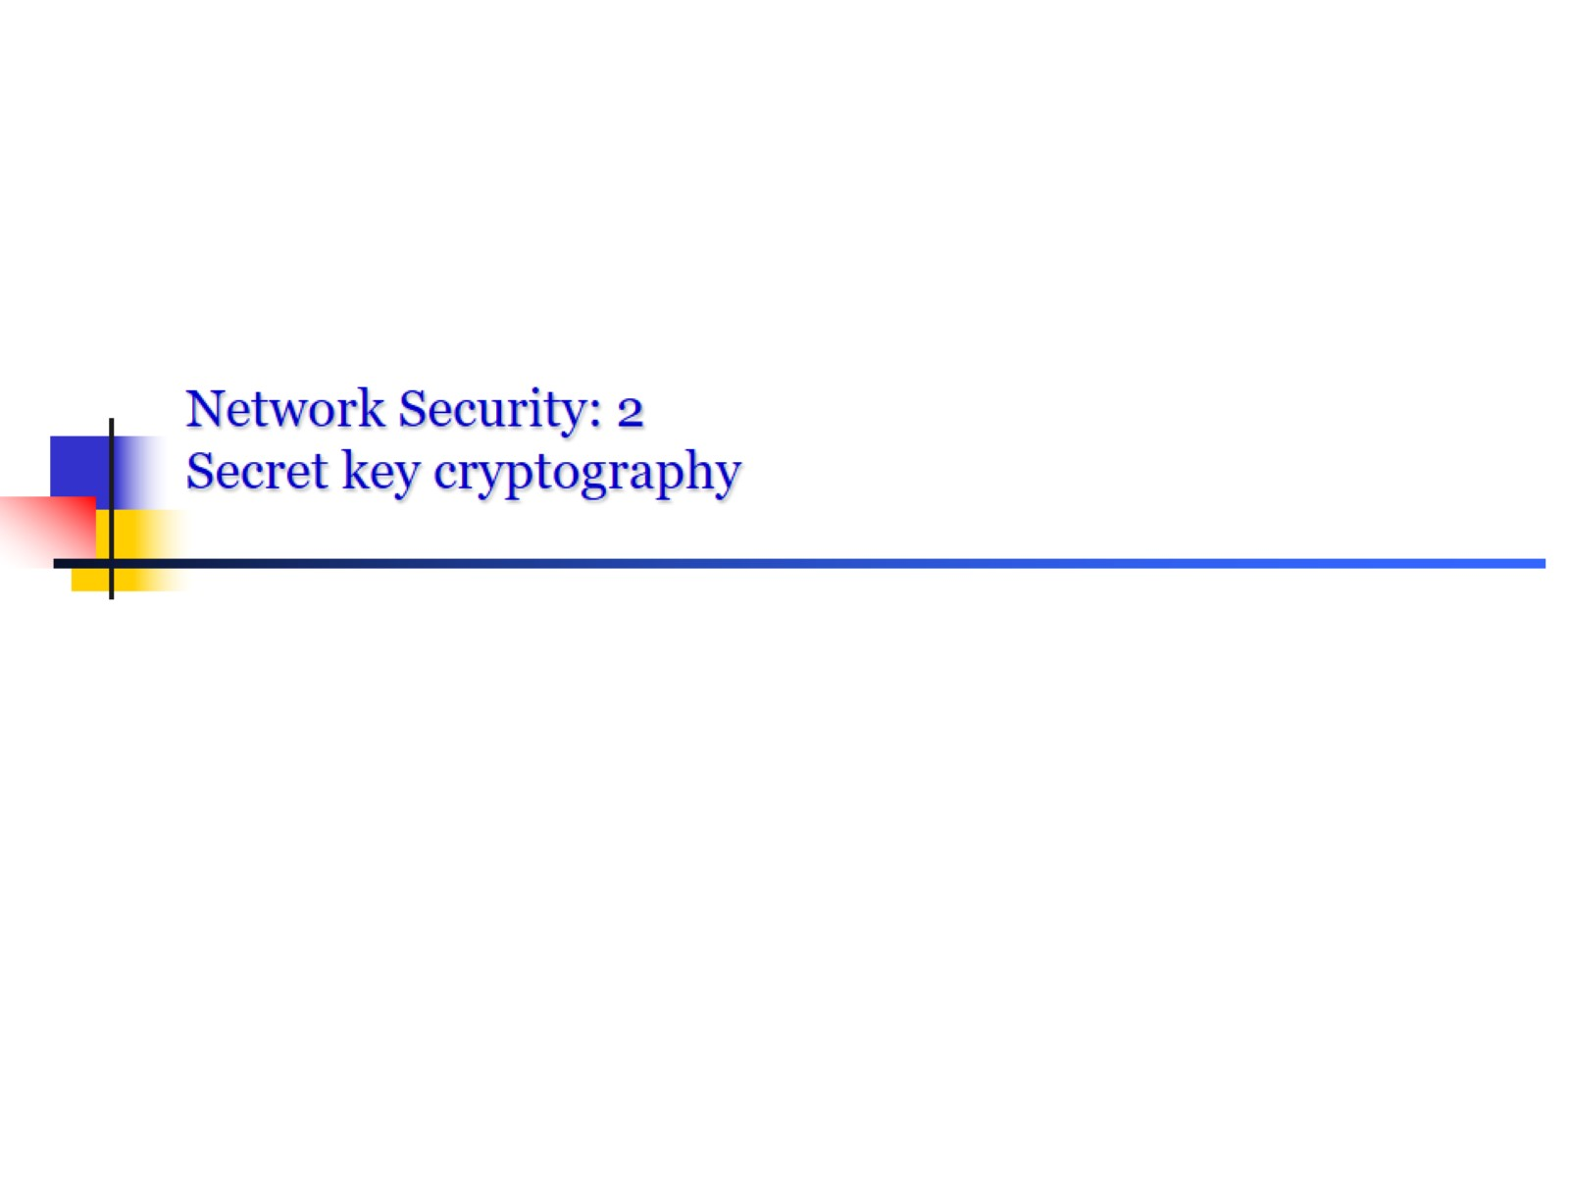
Network Security: 2 Secret key cryptography

Slide 2
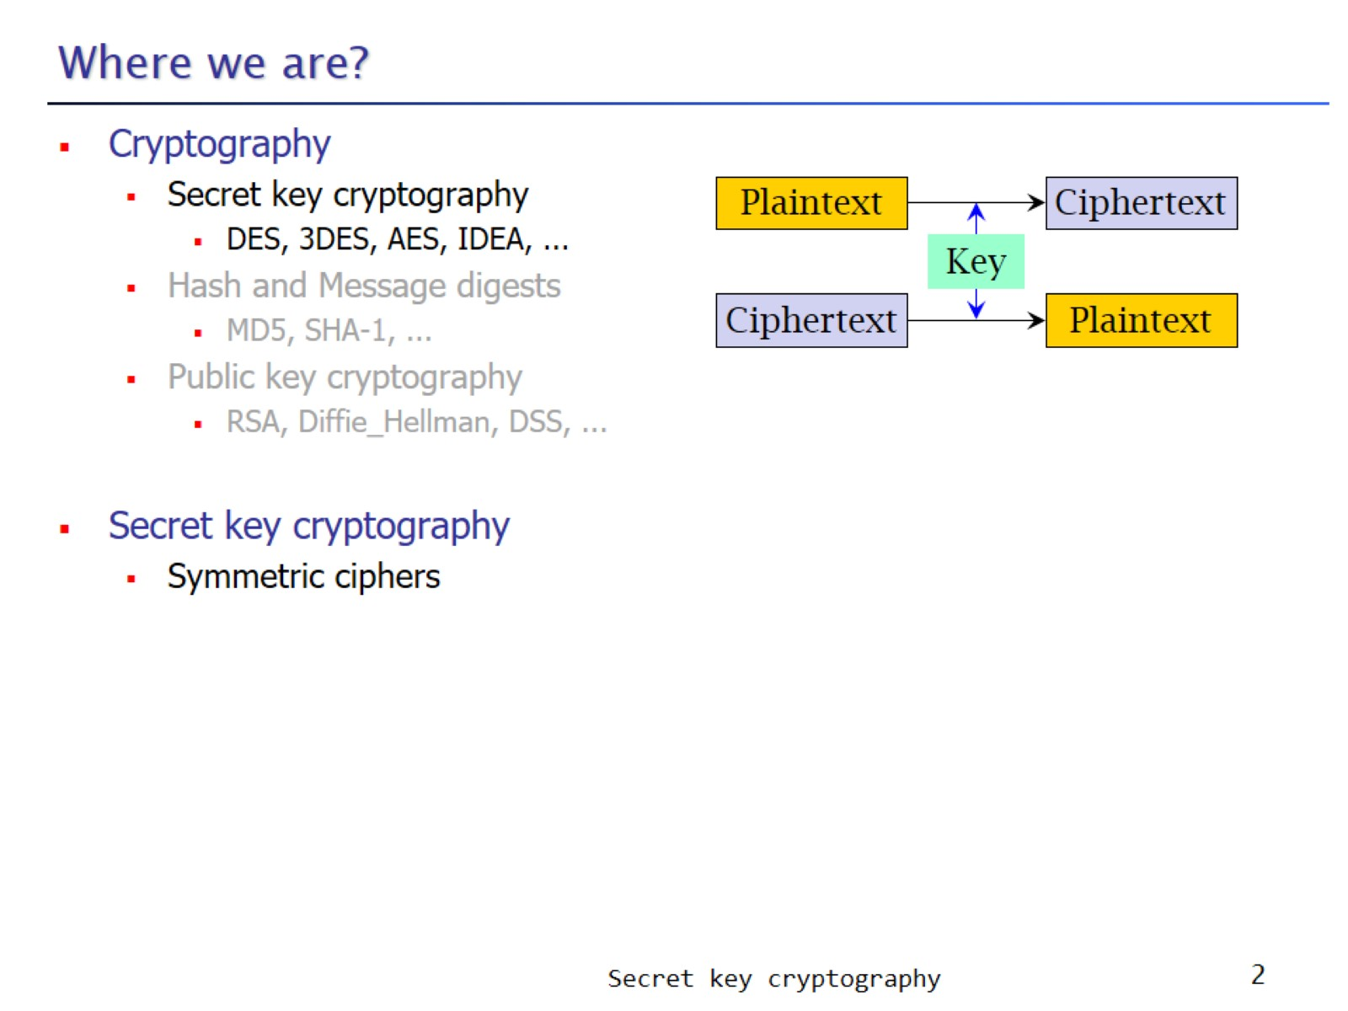
Where we are?

Slide 3
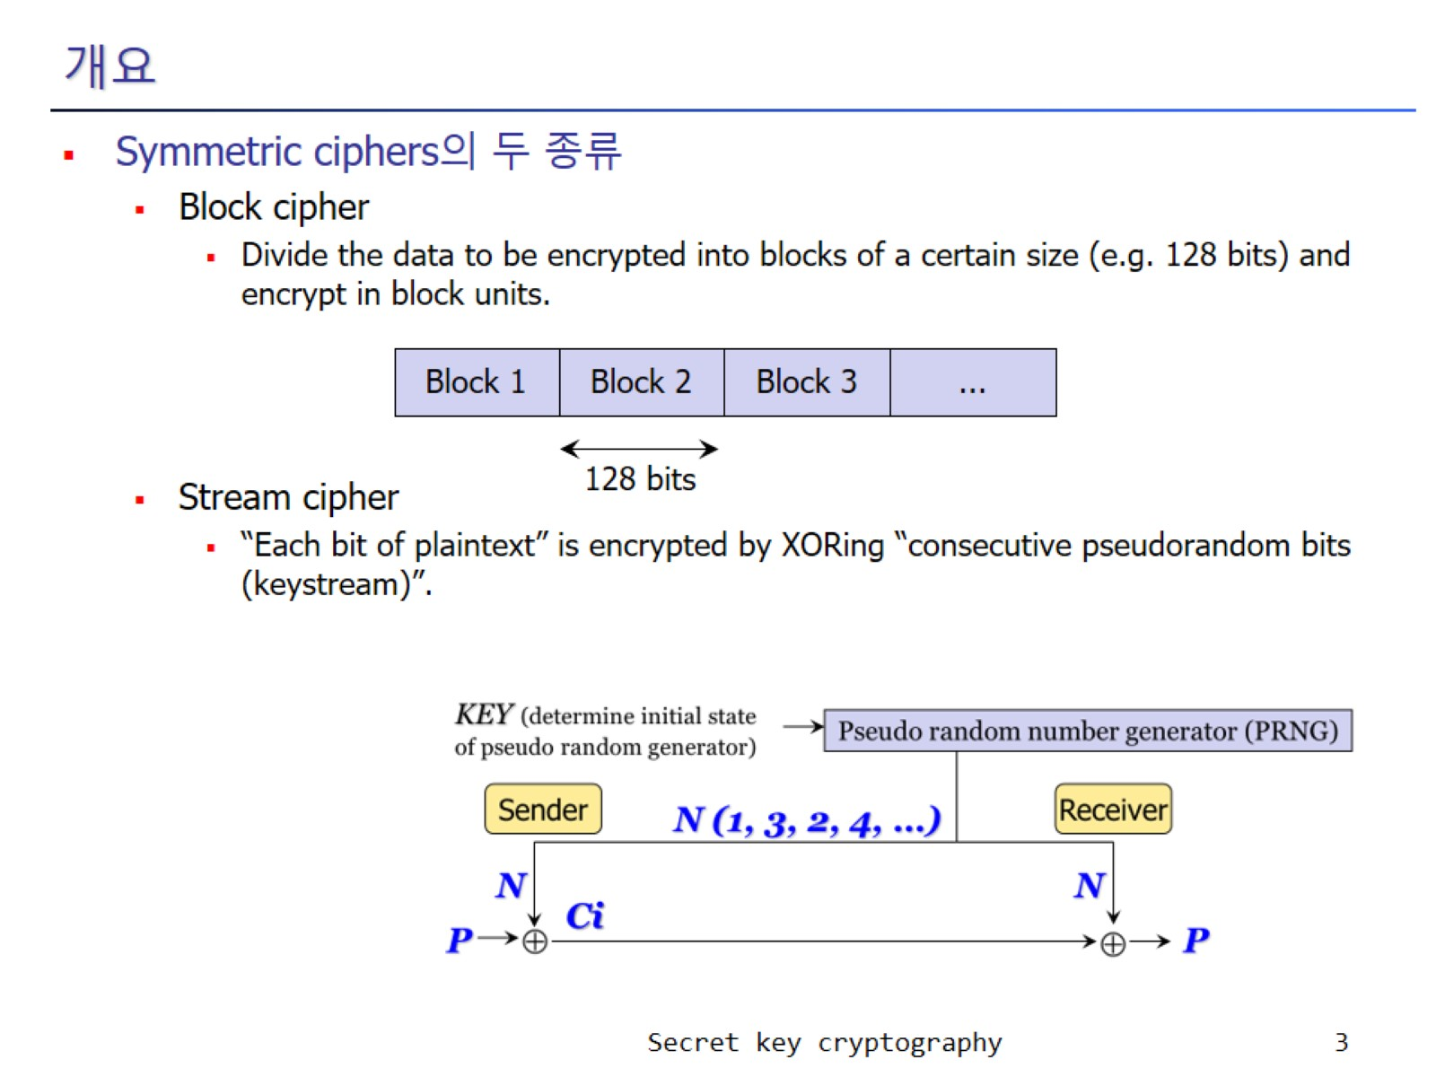
개요

Slide 4
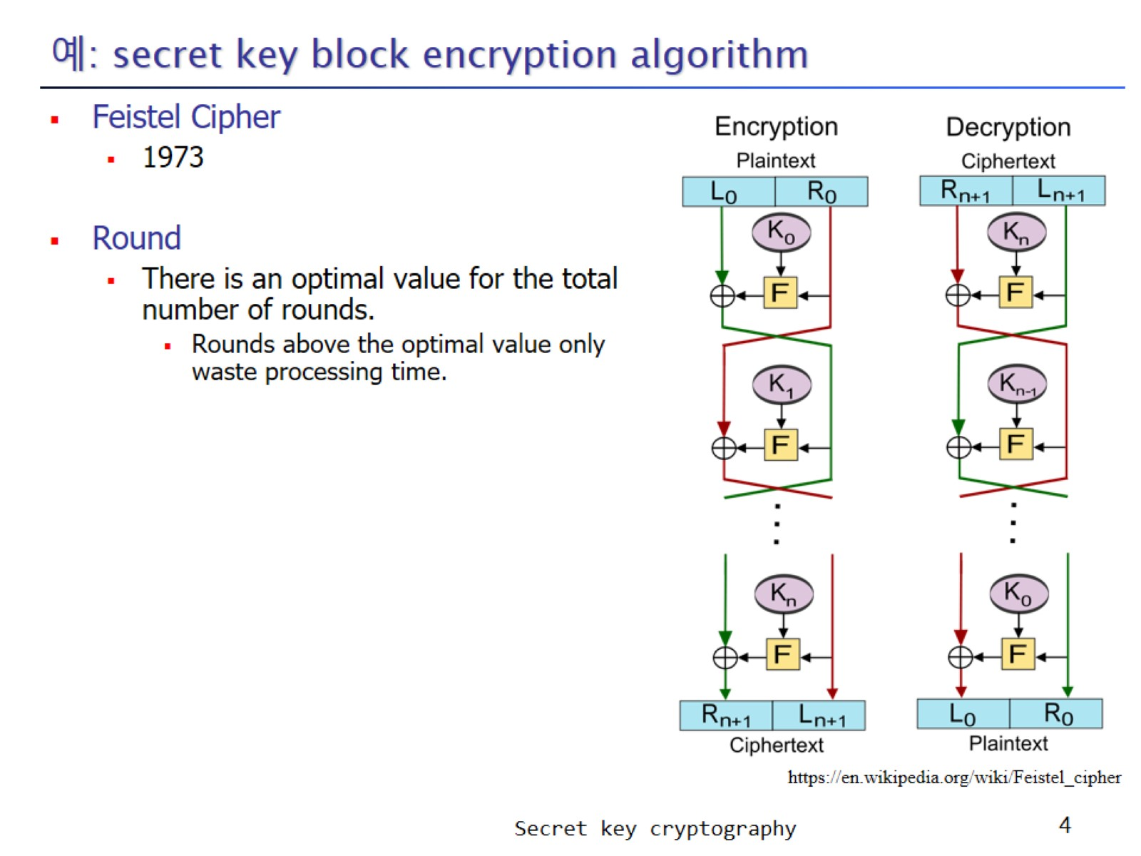
예: secret key block encryption algorithm

Slide 5
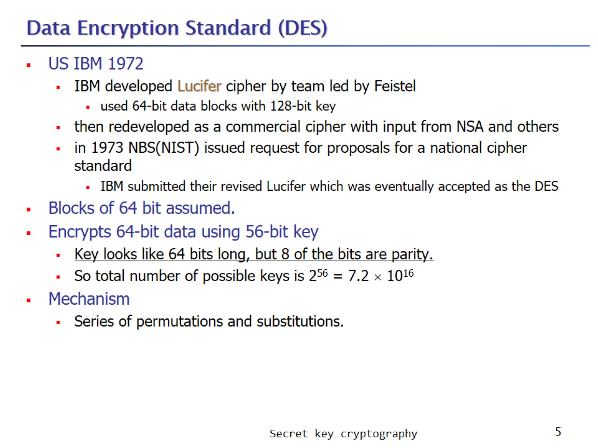
Data Encryption Standard (DES)

Slide 6
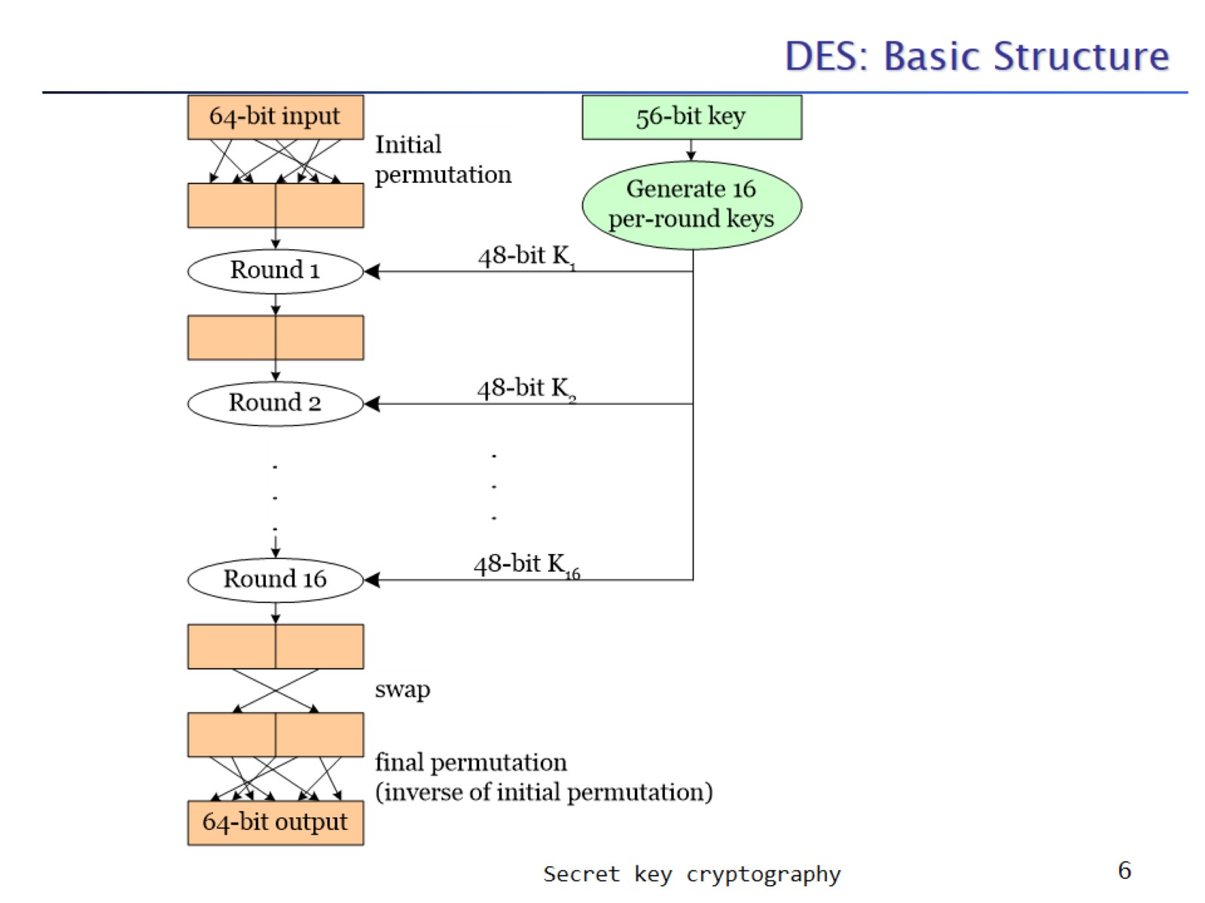
DES: Basic Structure

Slide 7
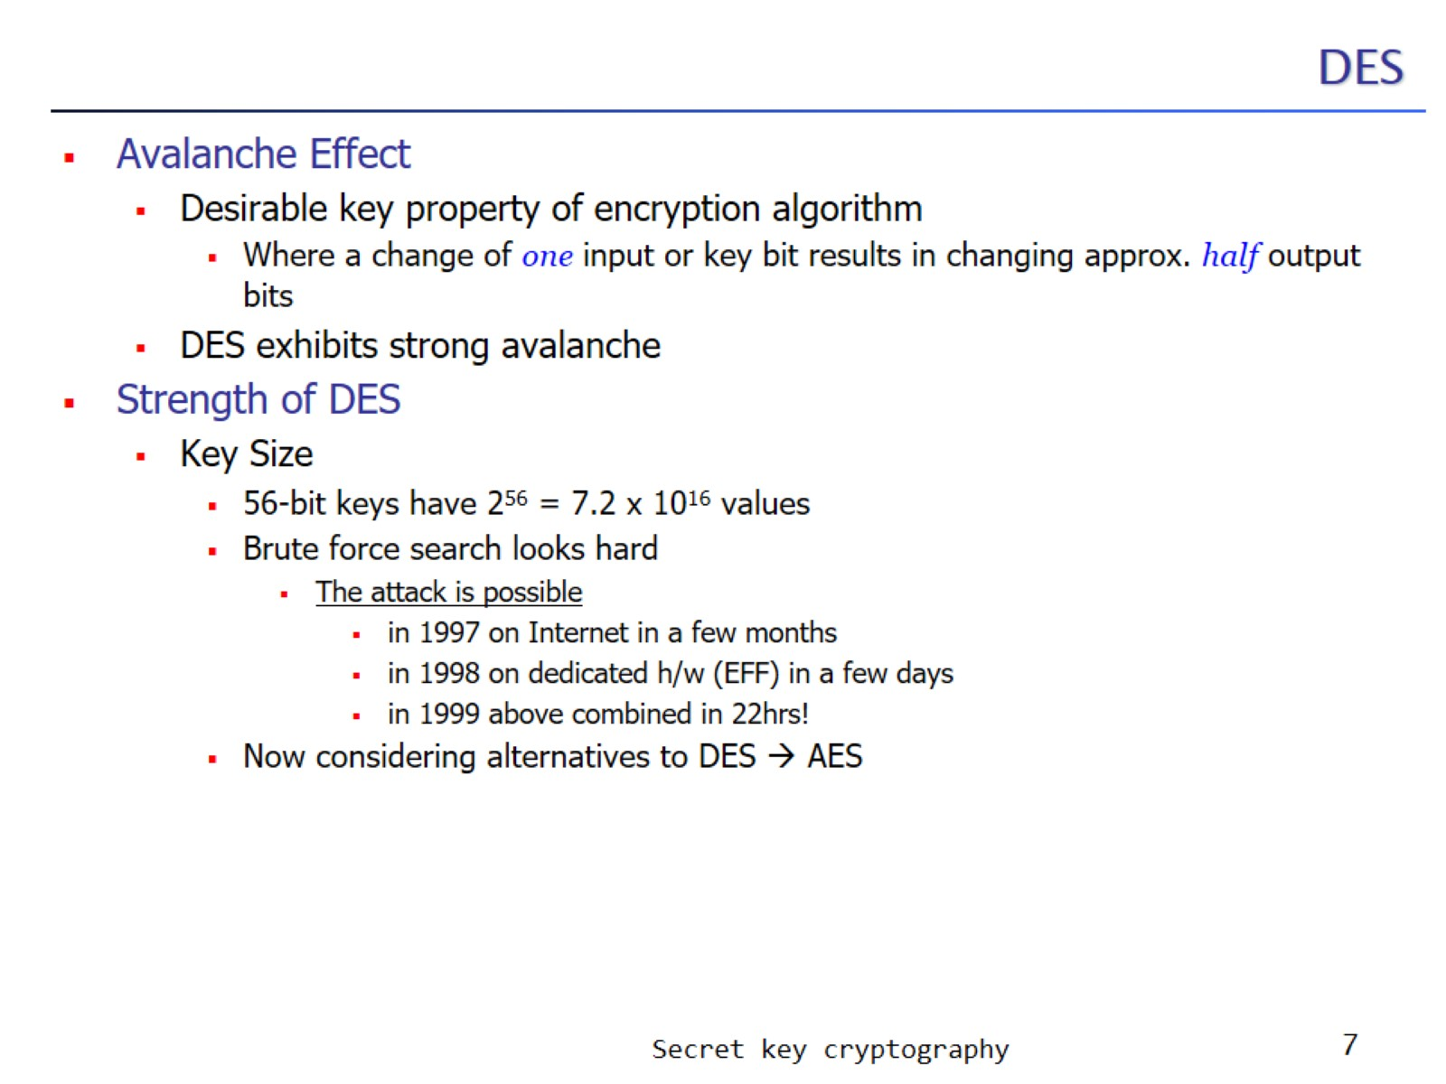
DES

Slide 8
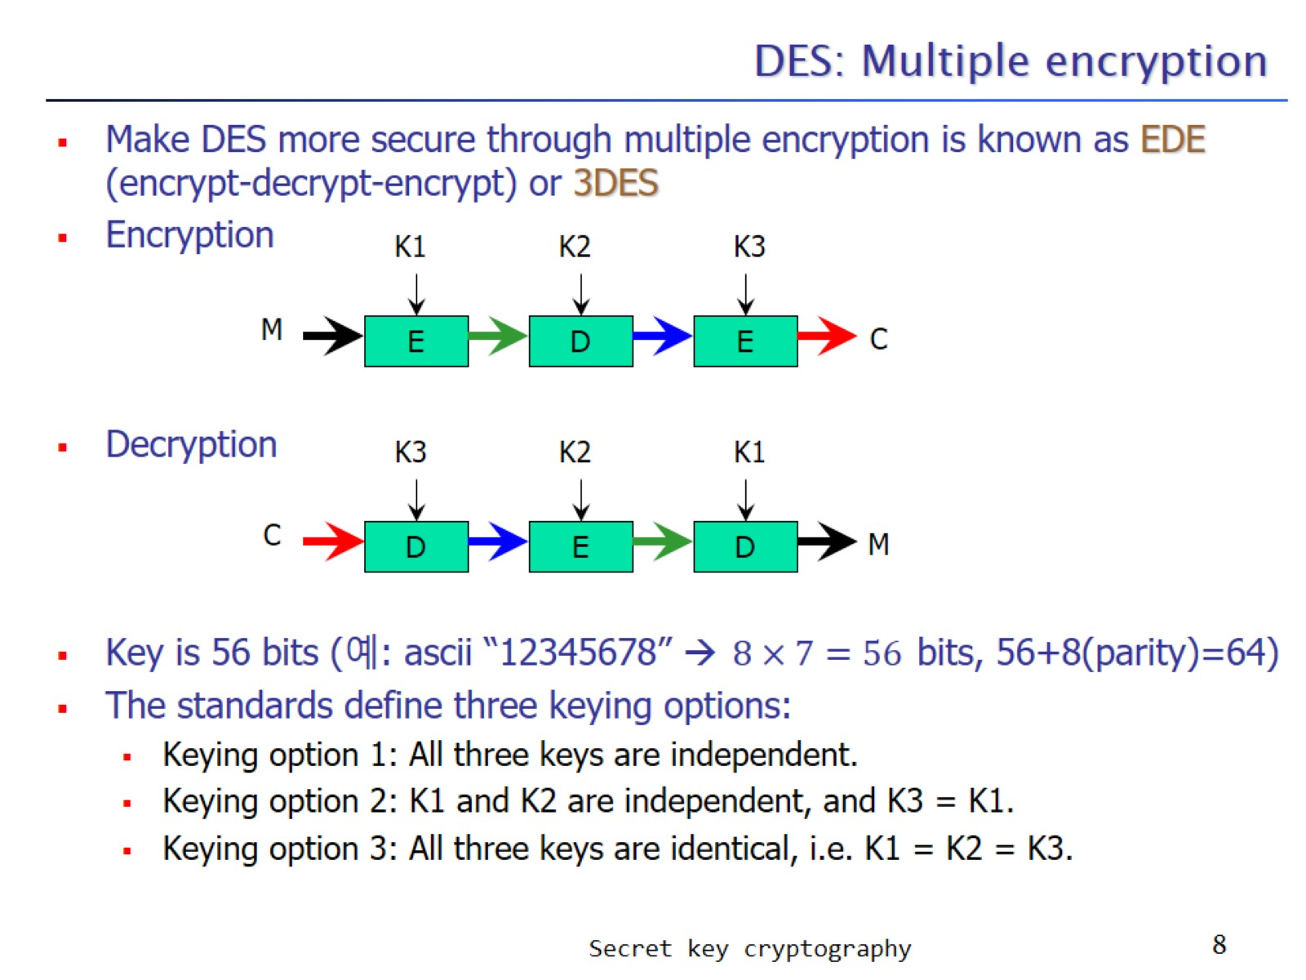
DES: Multiple encryption

Slide 9
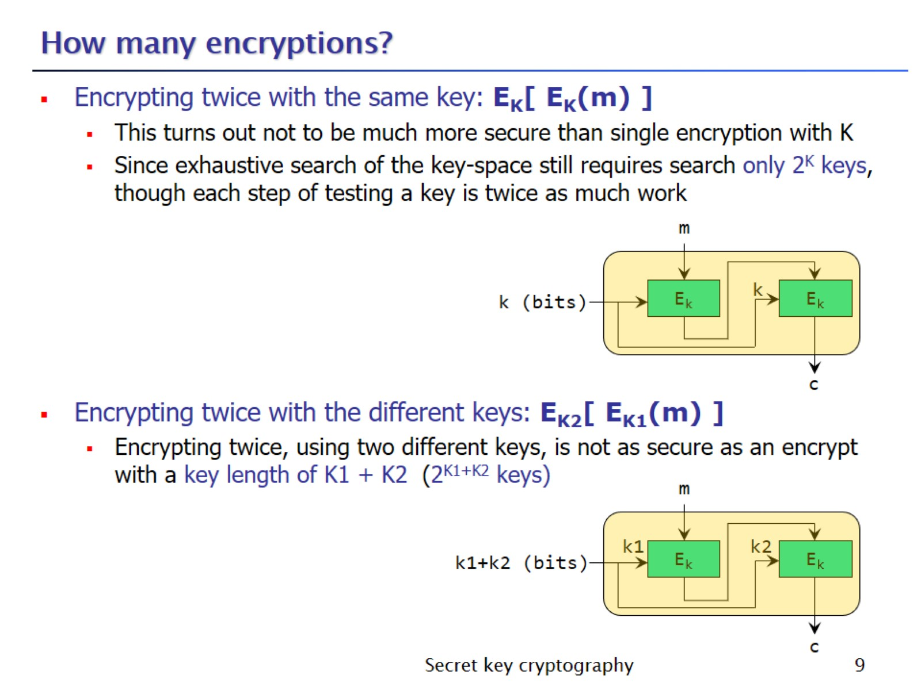
How many encryptions?

Slide 10
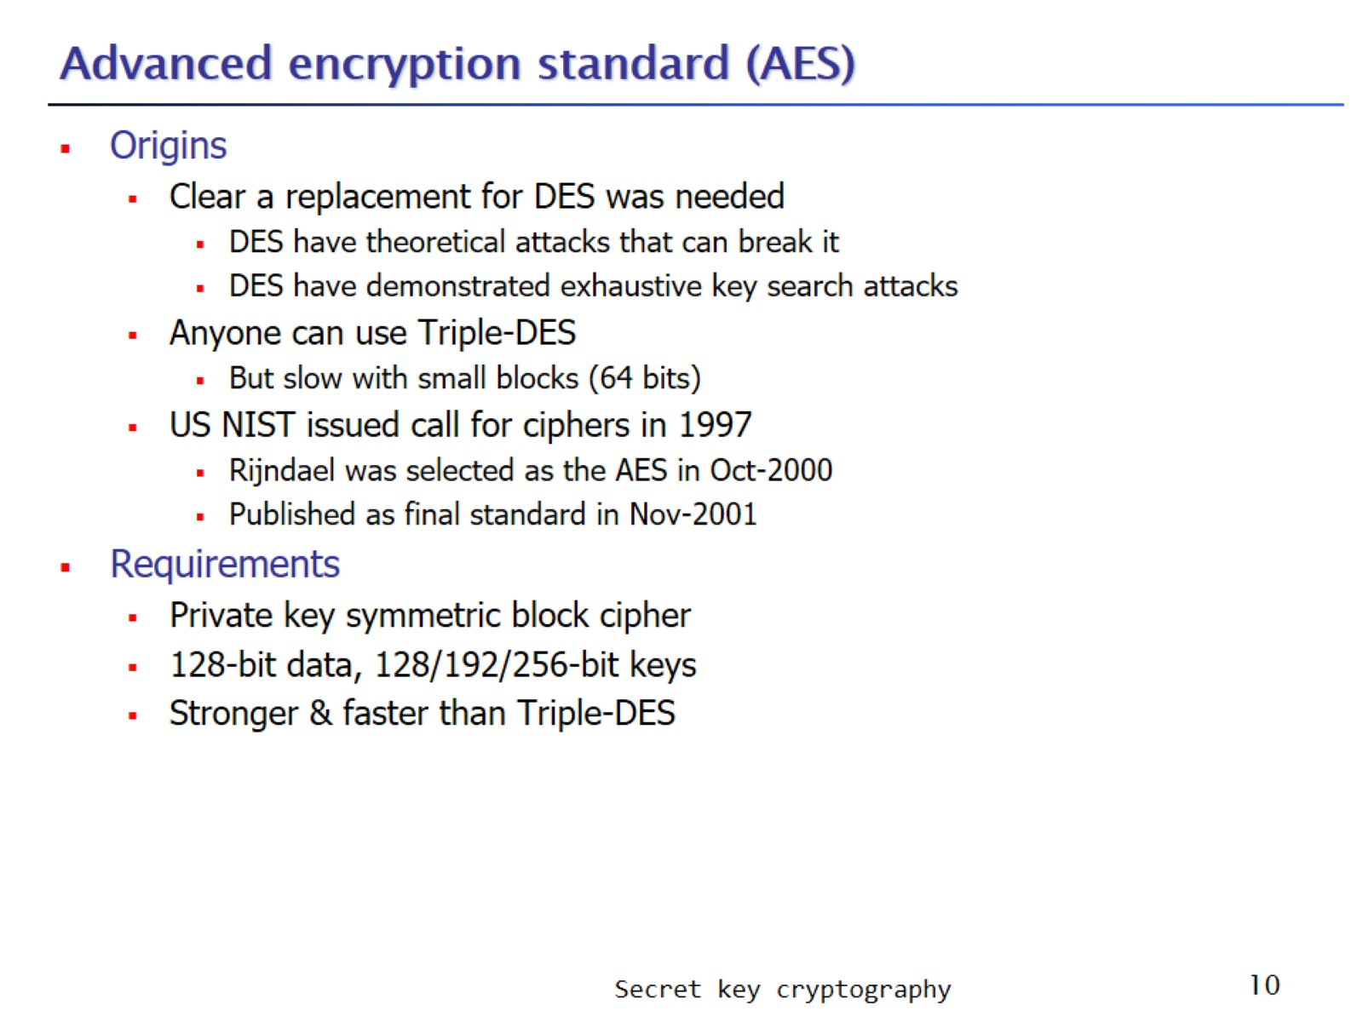
Advanced encryption standard (AES)

Slide 11
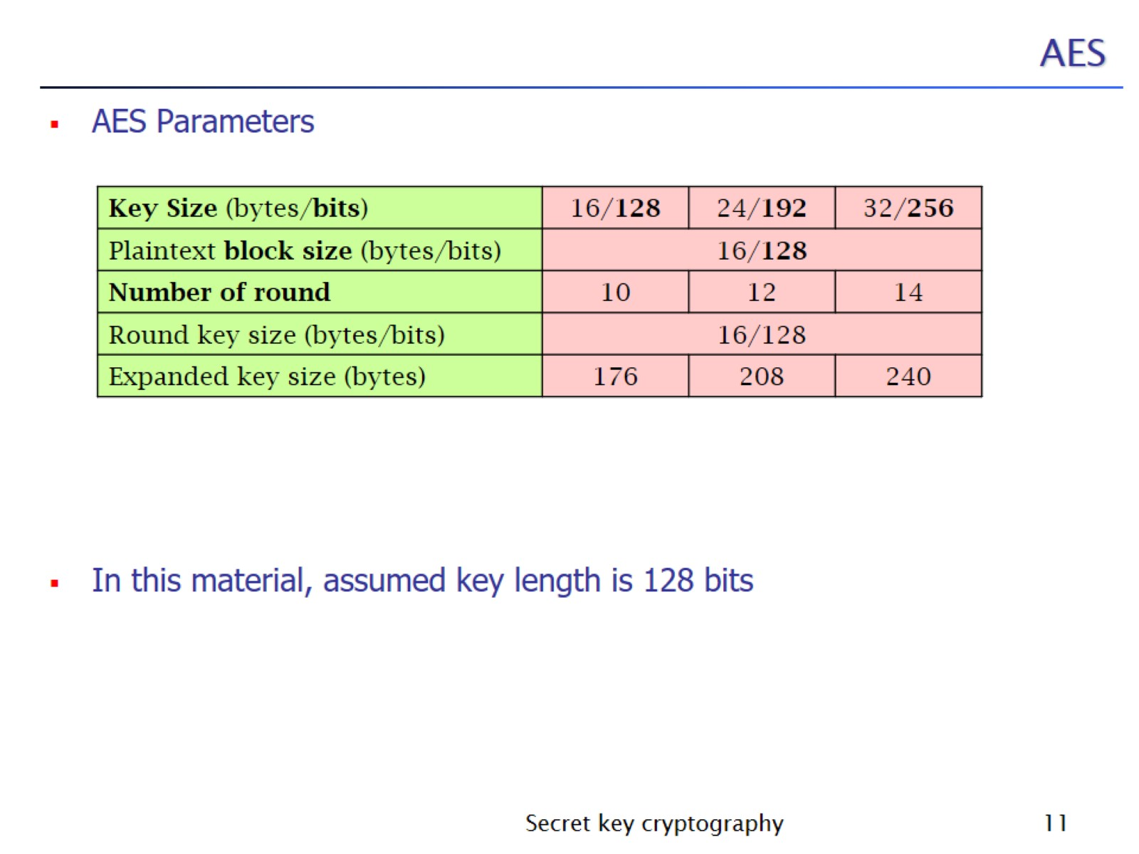
AES

Slide 12
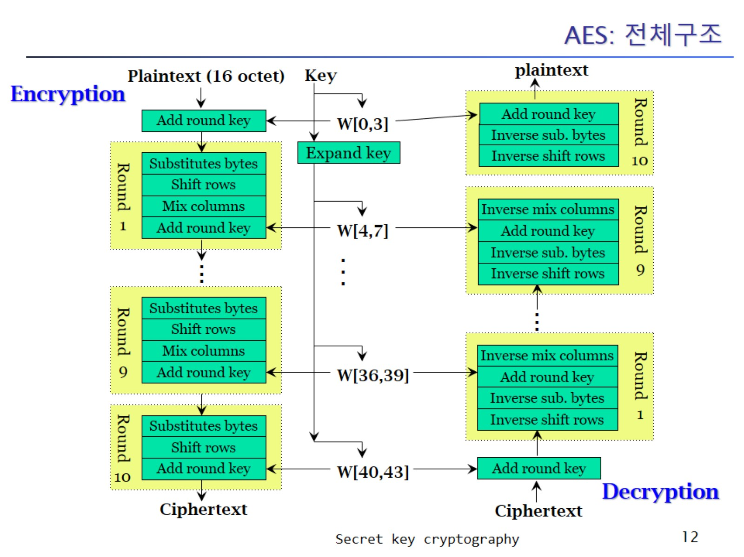
AES: 전체구조

Slide 13
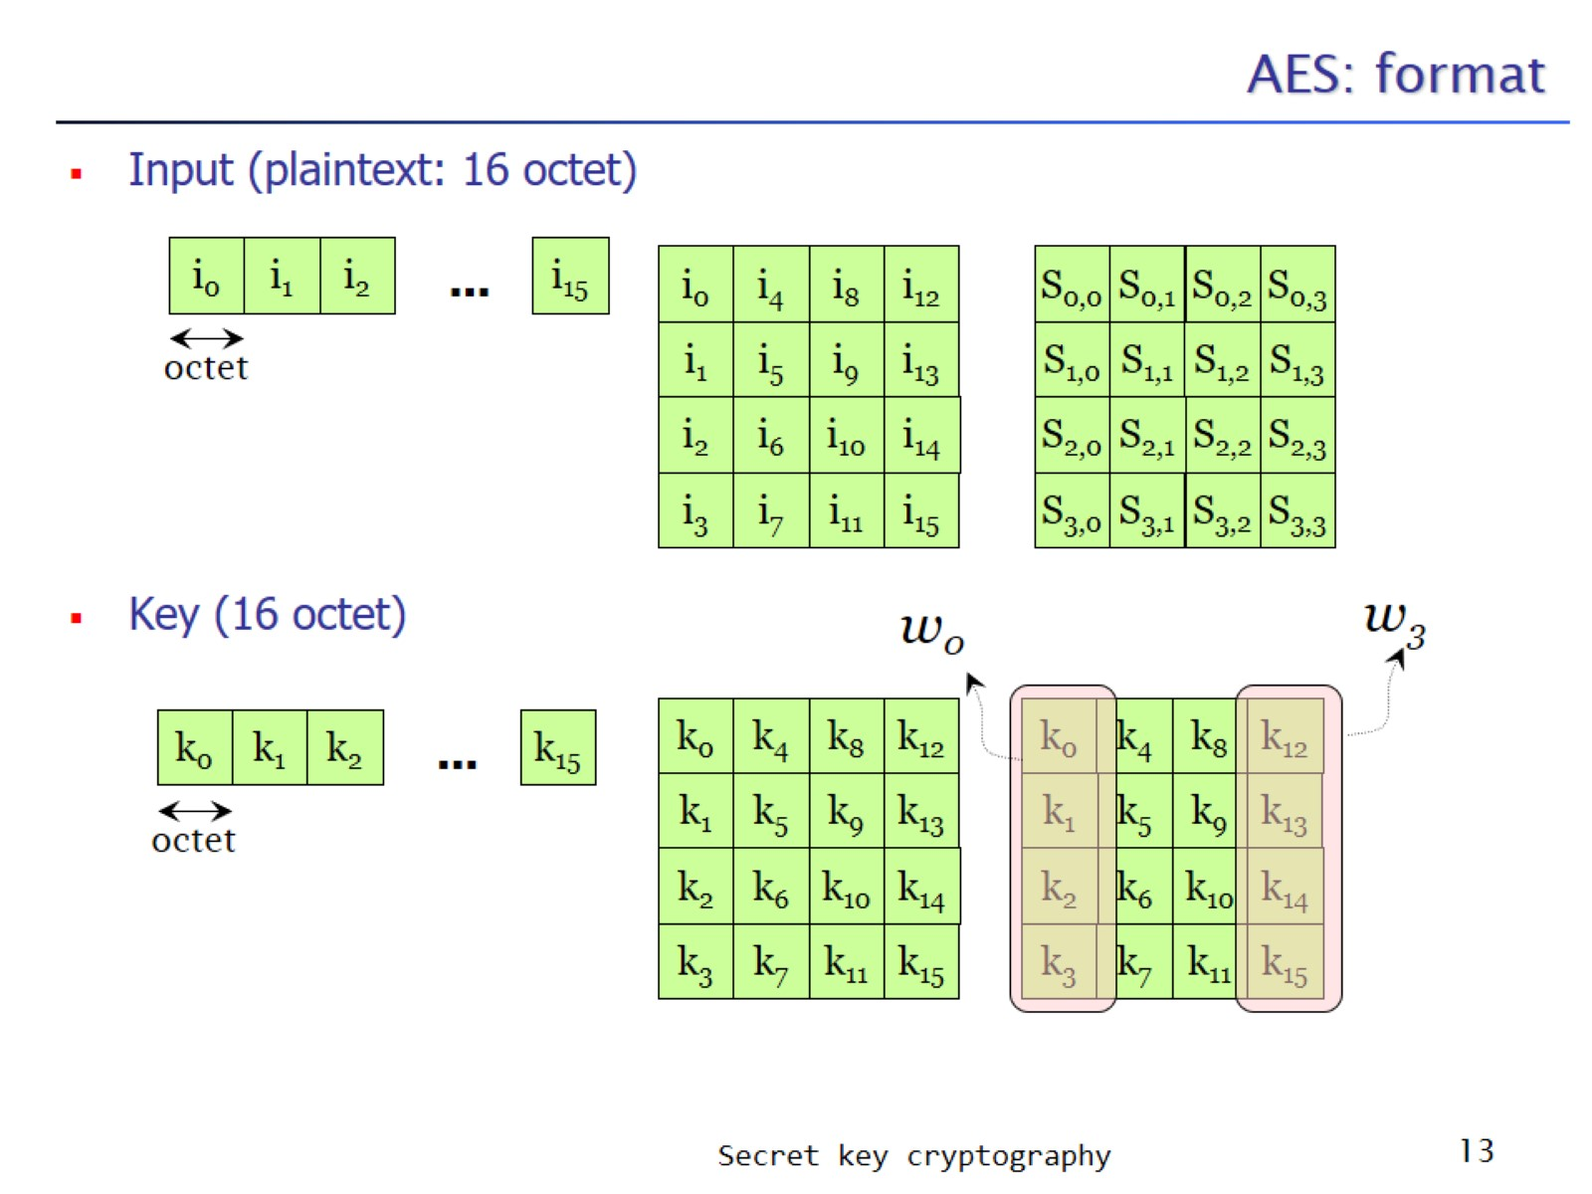
AES: format

Slide 14
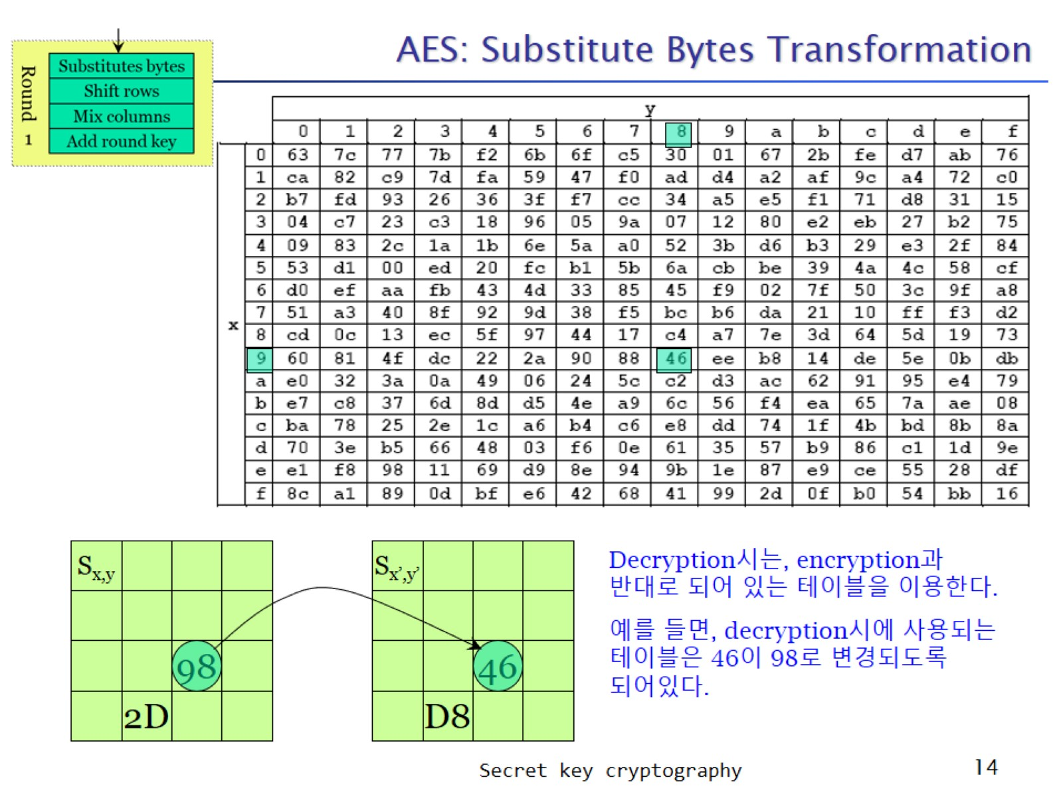
AES: Substitute Bytes Transformation

Slide 15
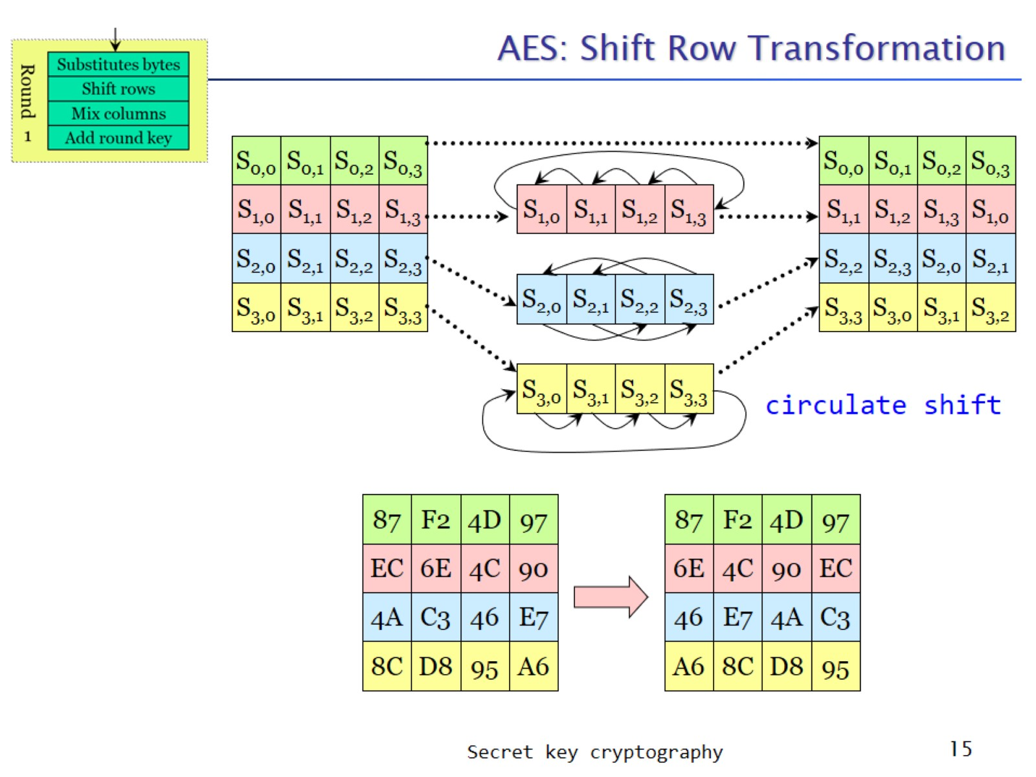
AES: Shift Row Transformation

Slide 16
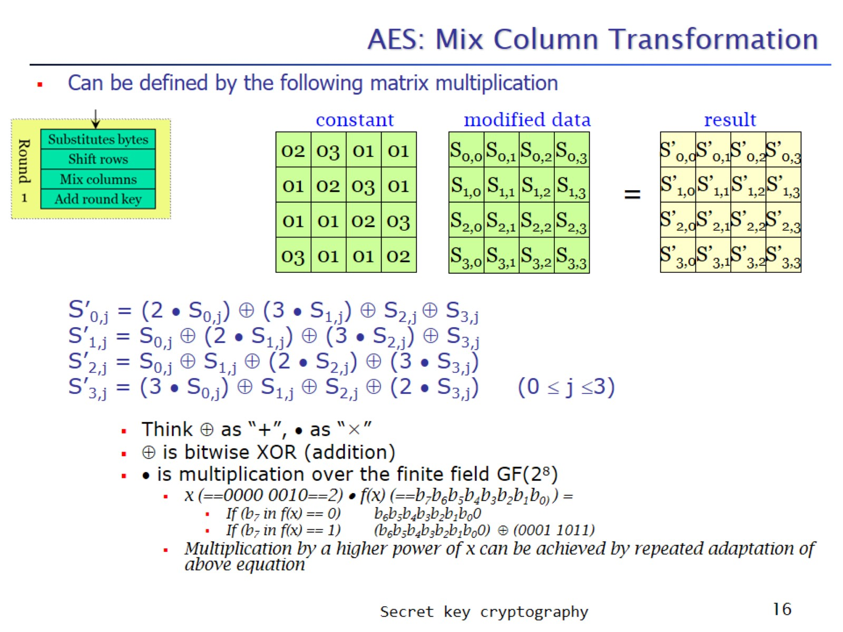
AES: Mix Column Transformation

Slide 17
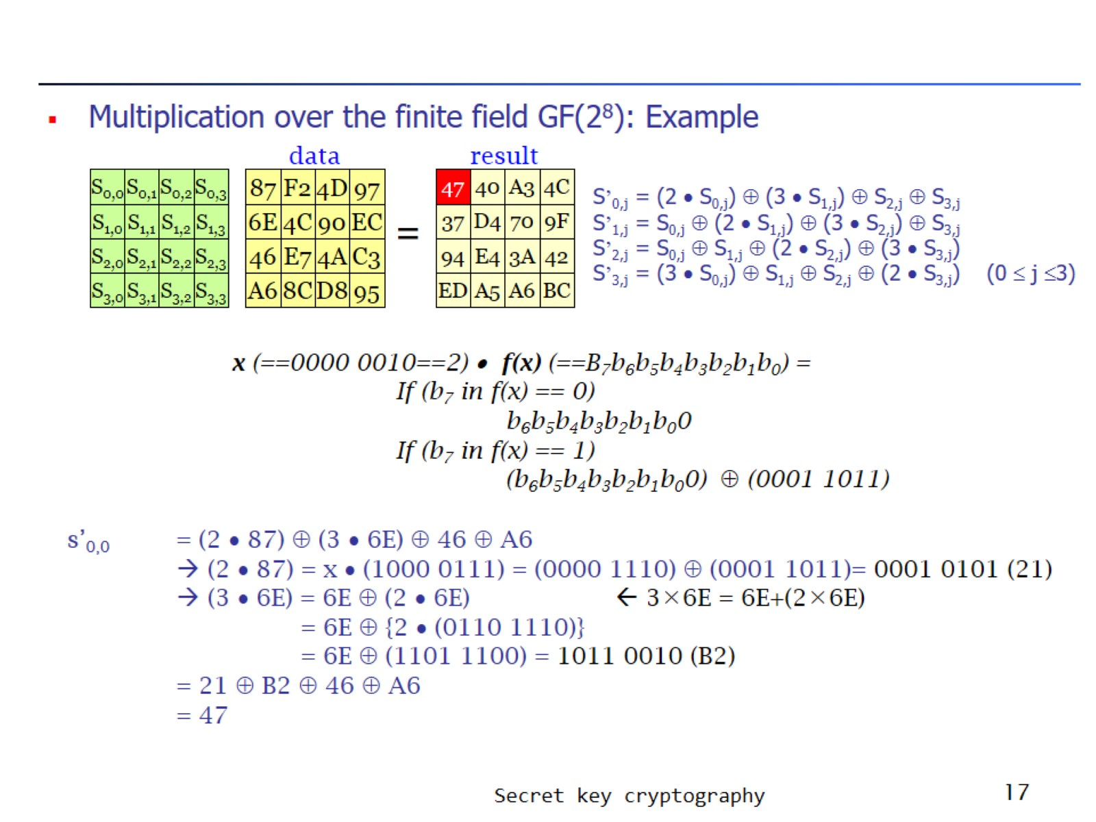

Slide 18
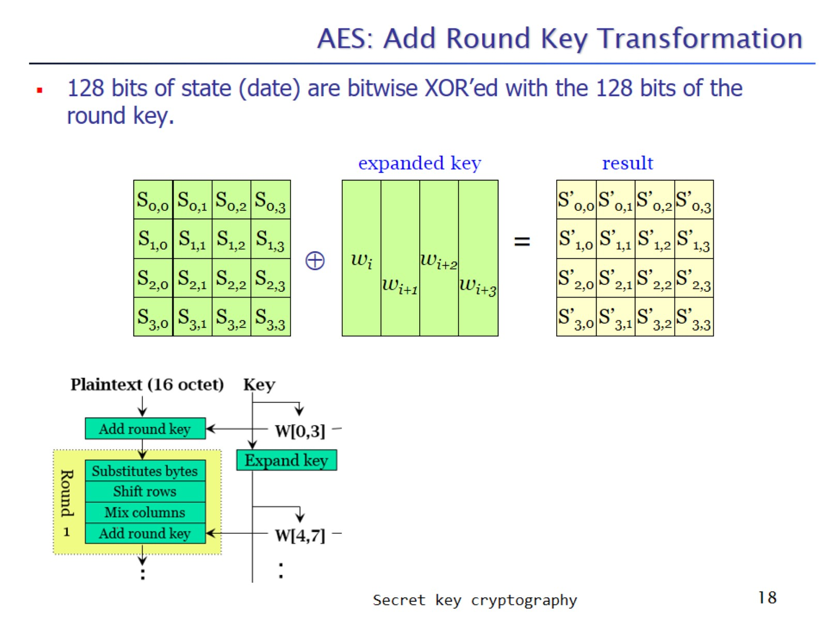
AES: Add Round Key Transformation

Slide 19
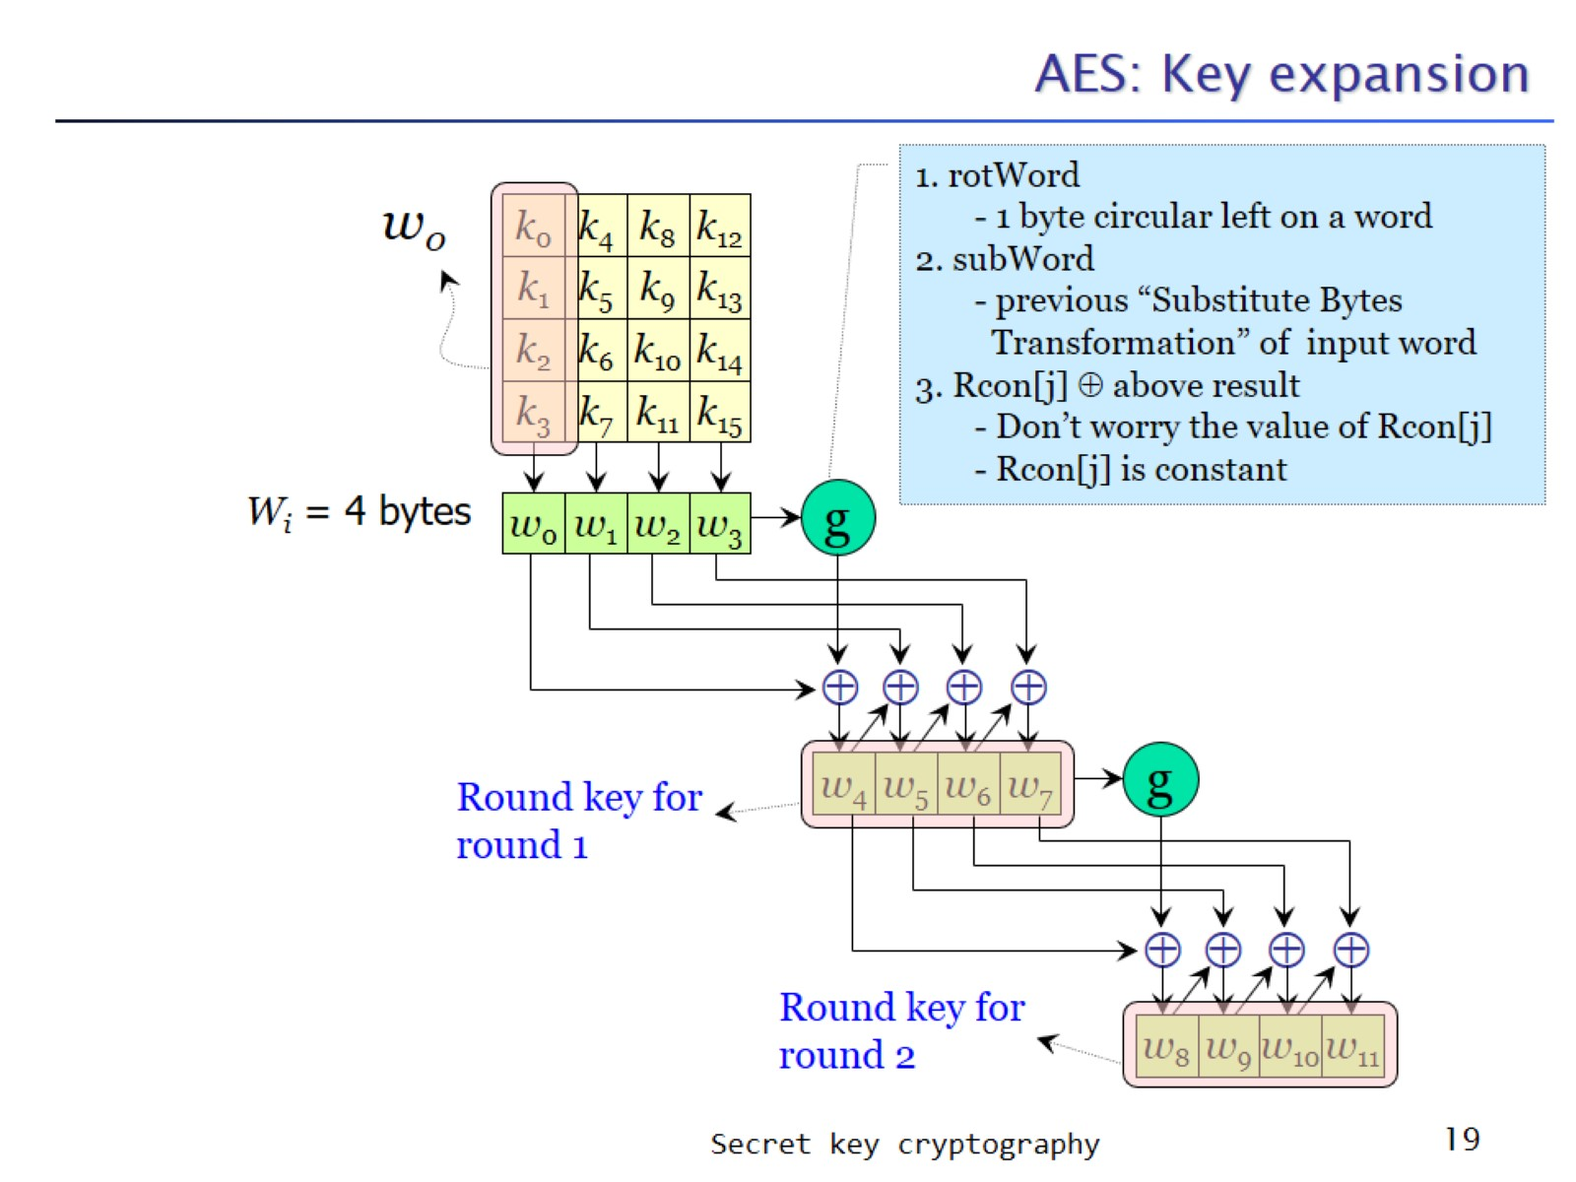
AES: Key expansion

Slide 20
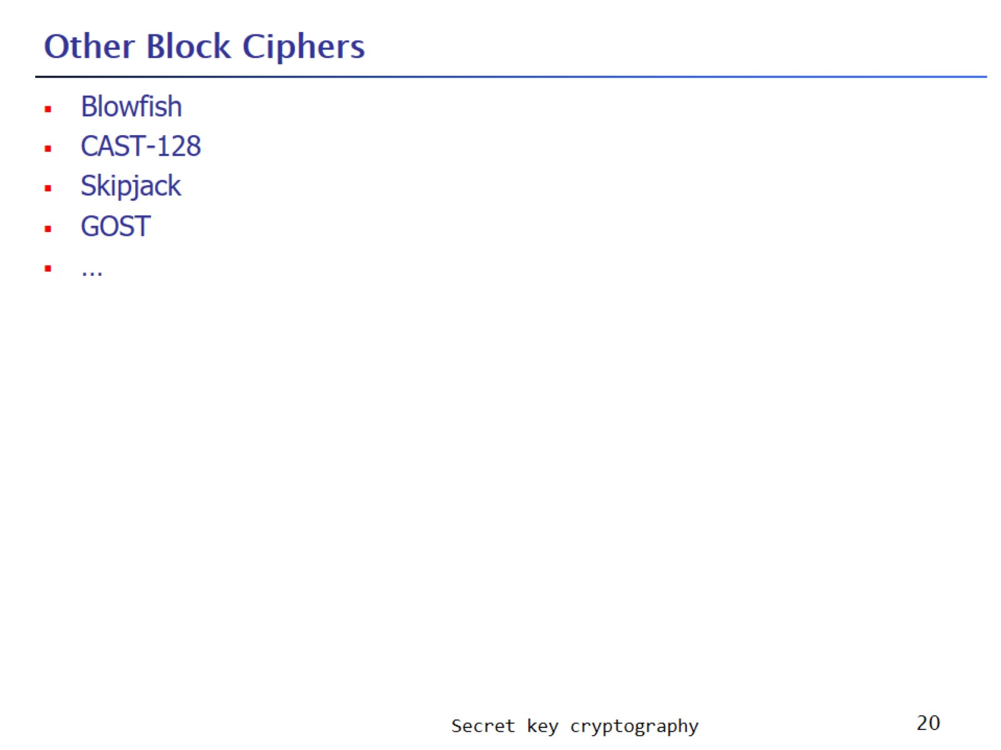
Other Block Ciphers

Slide 21
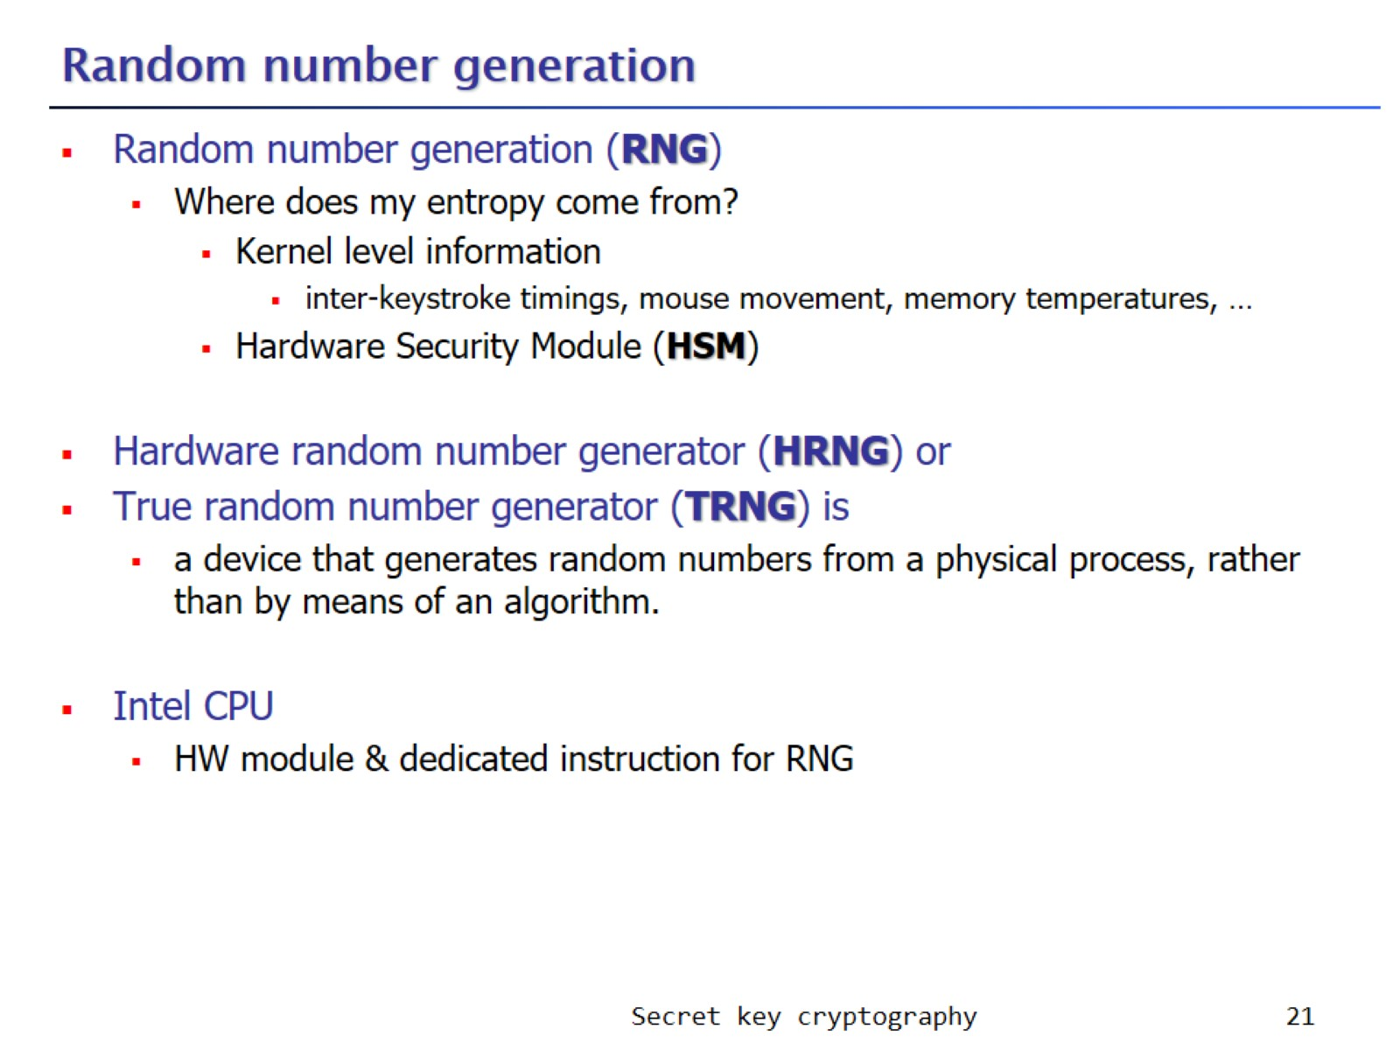
Random number generation

Slide 22
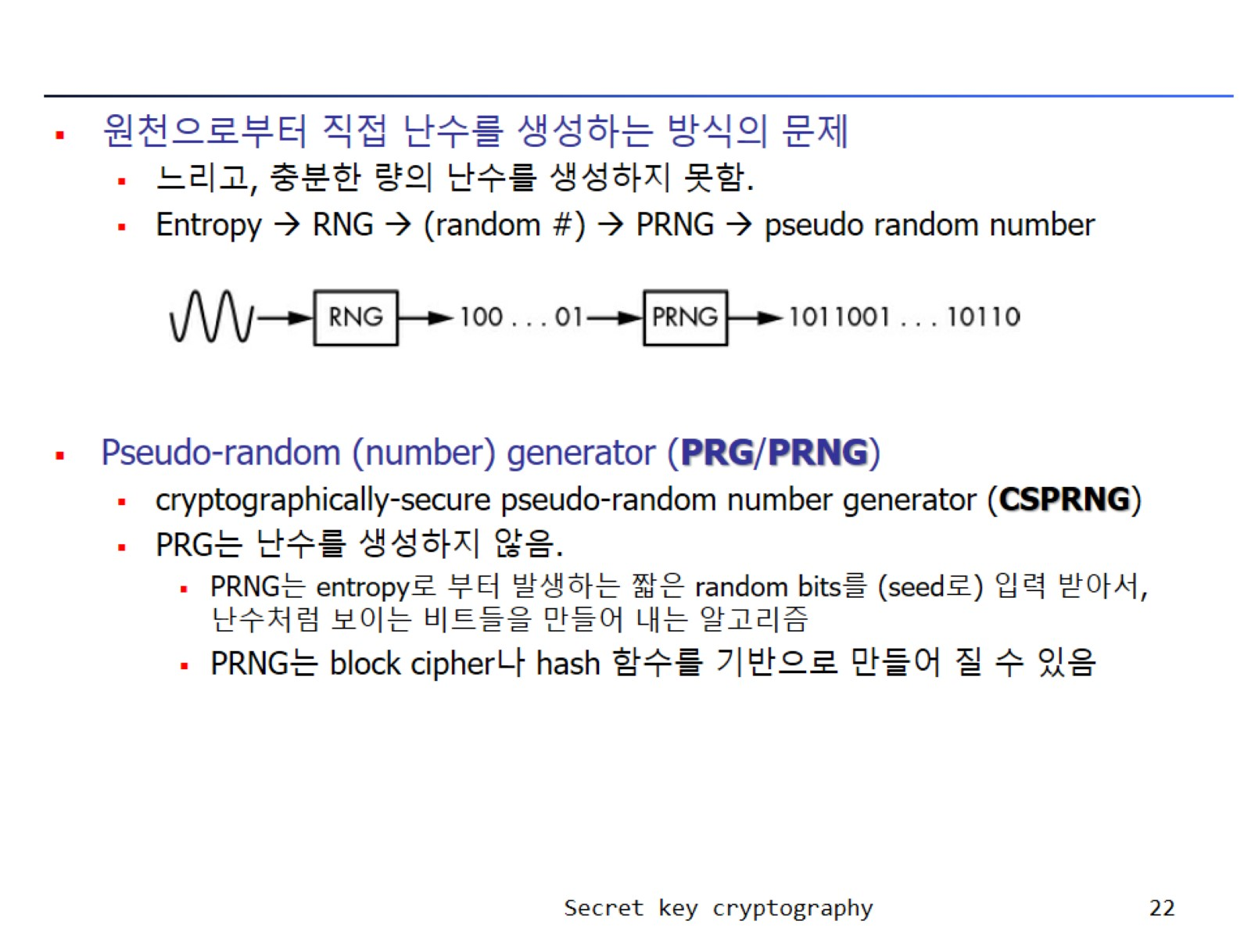

Slide 23
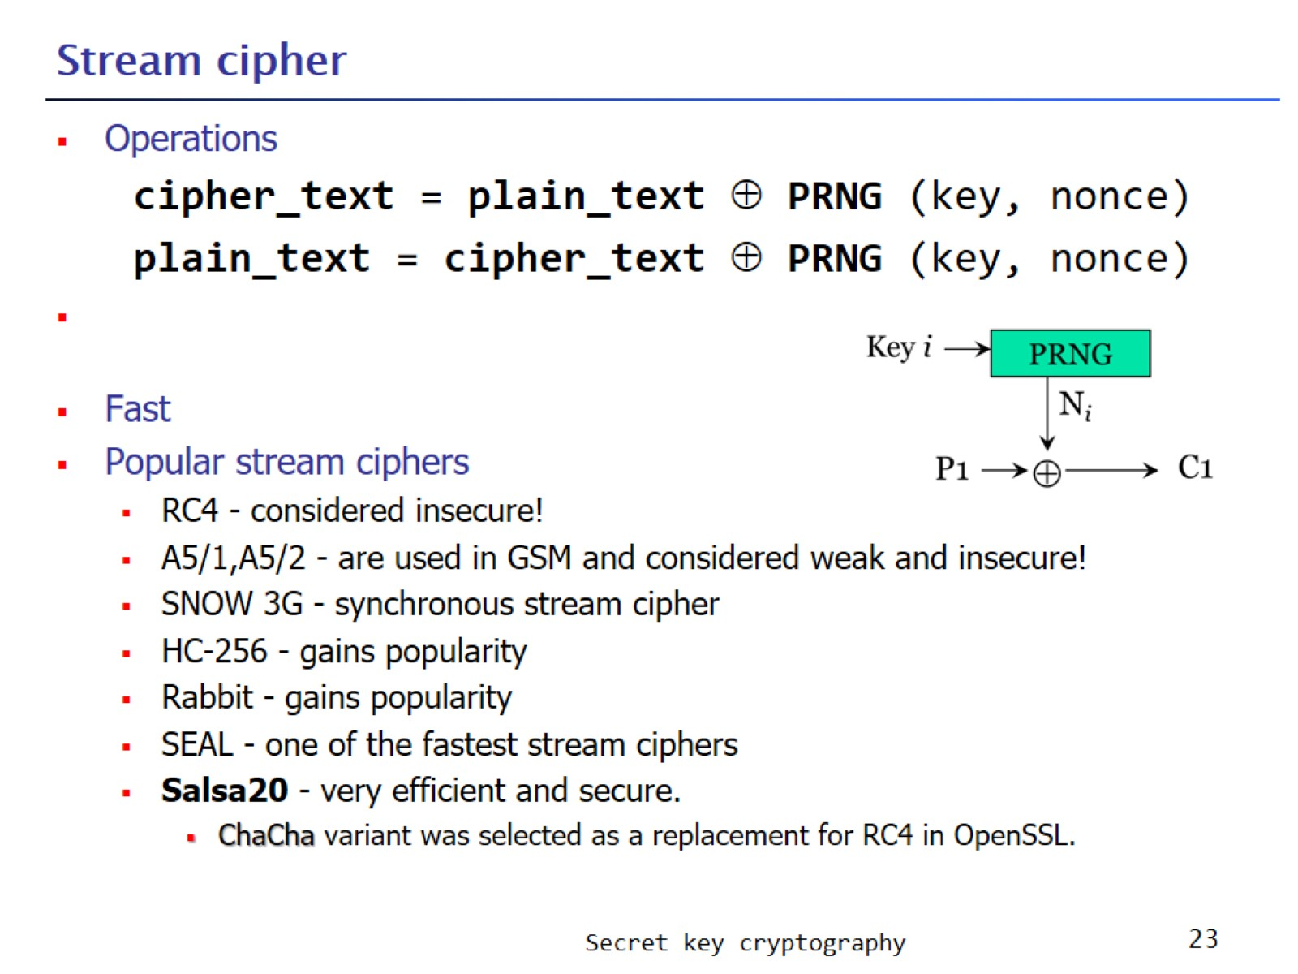
Stream cipher

Slide 24
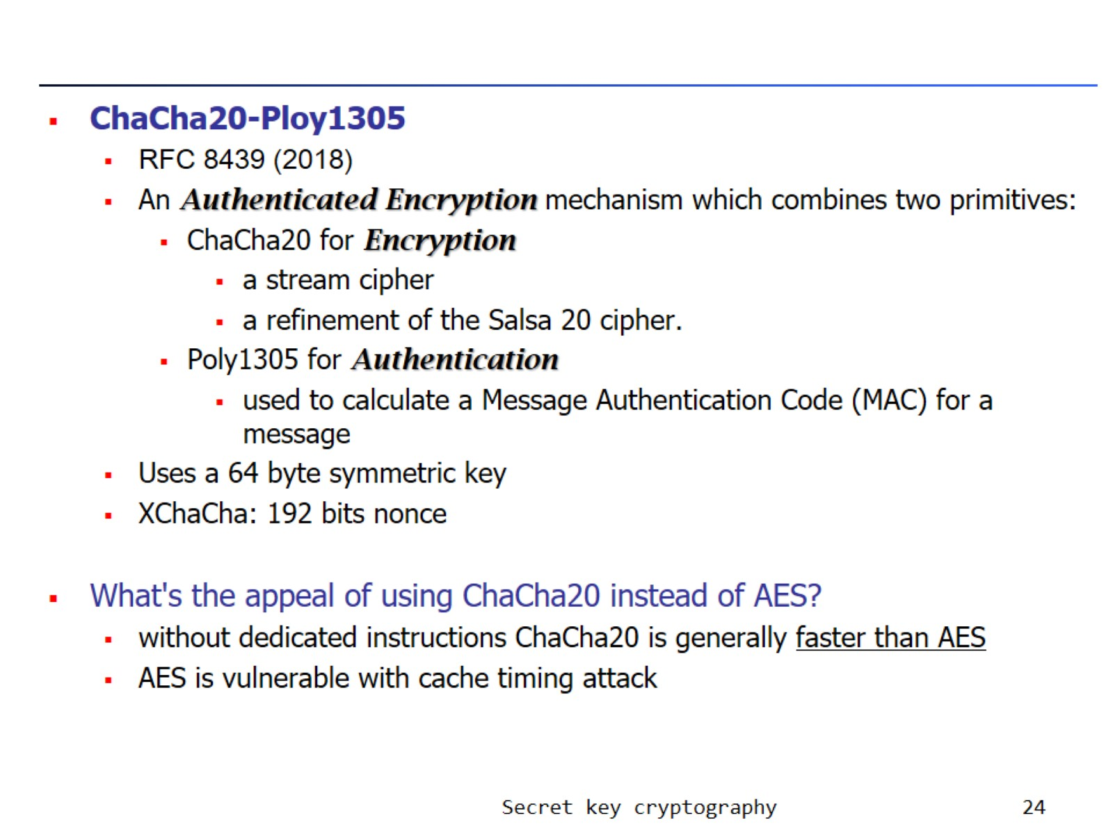

Slide 25
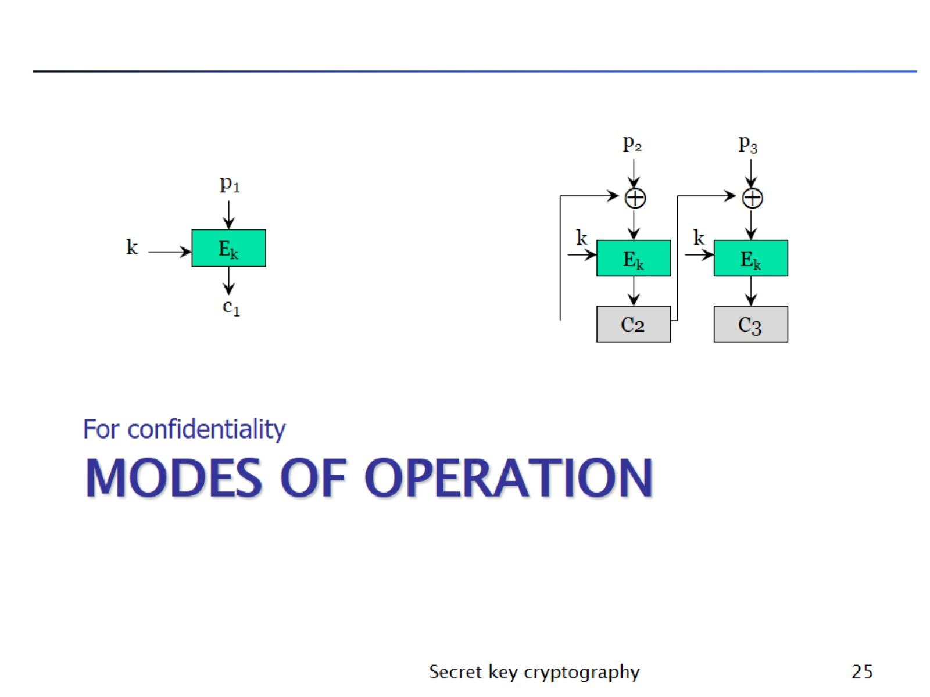
Modes of Operation

Slide 26
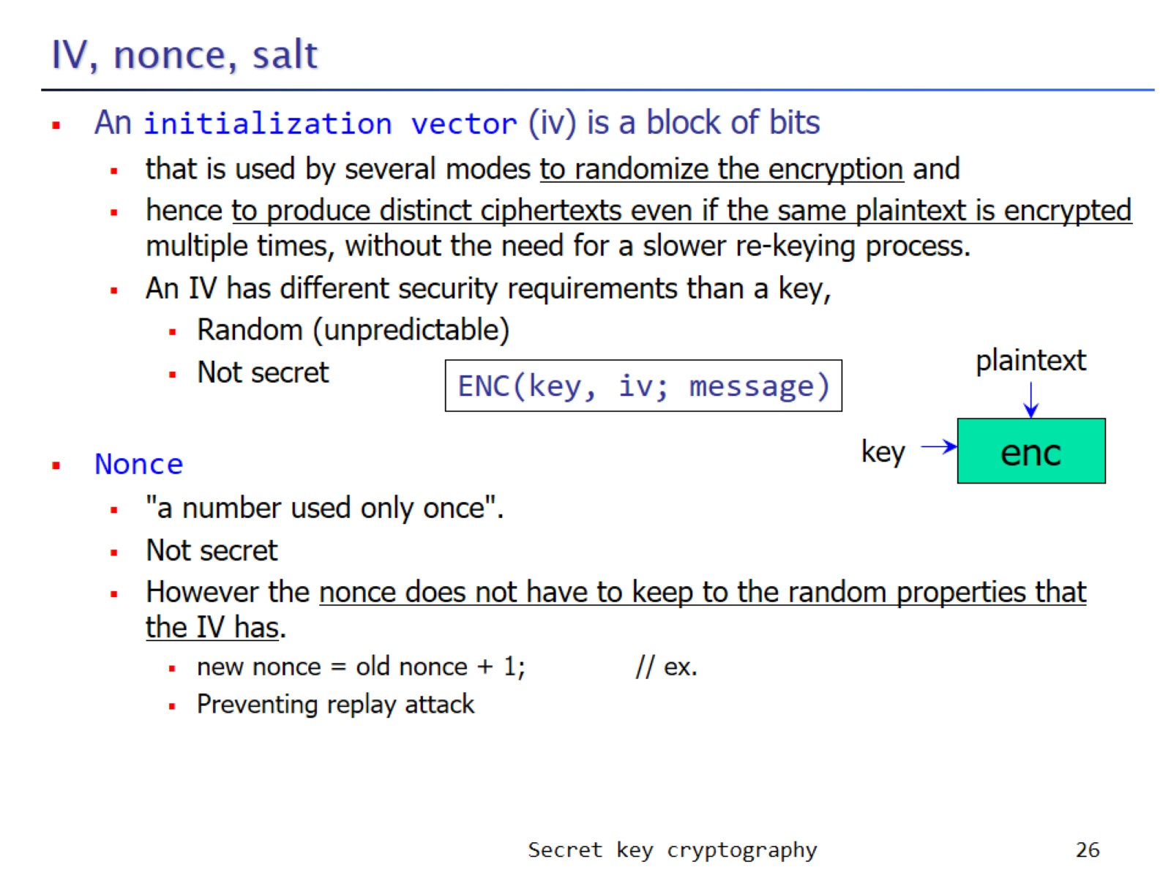
IV, nonce, salt

Slide 27
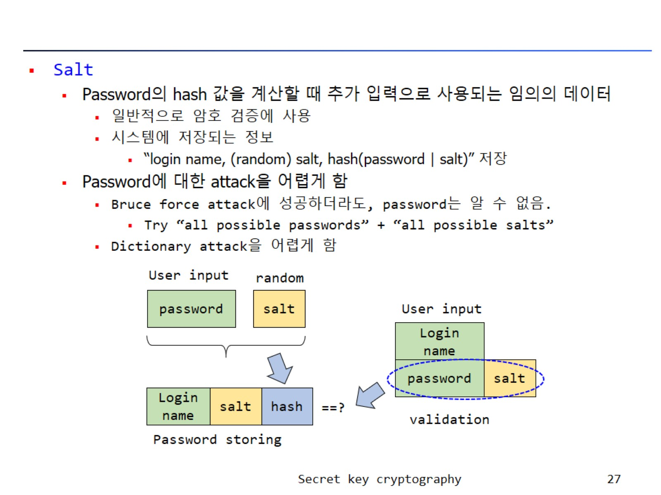

Slide 28
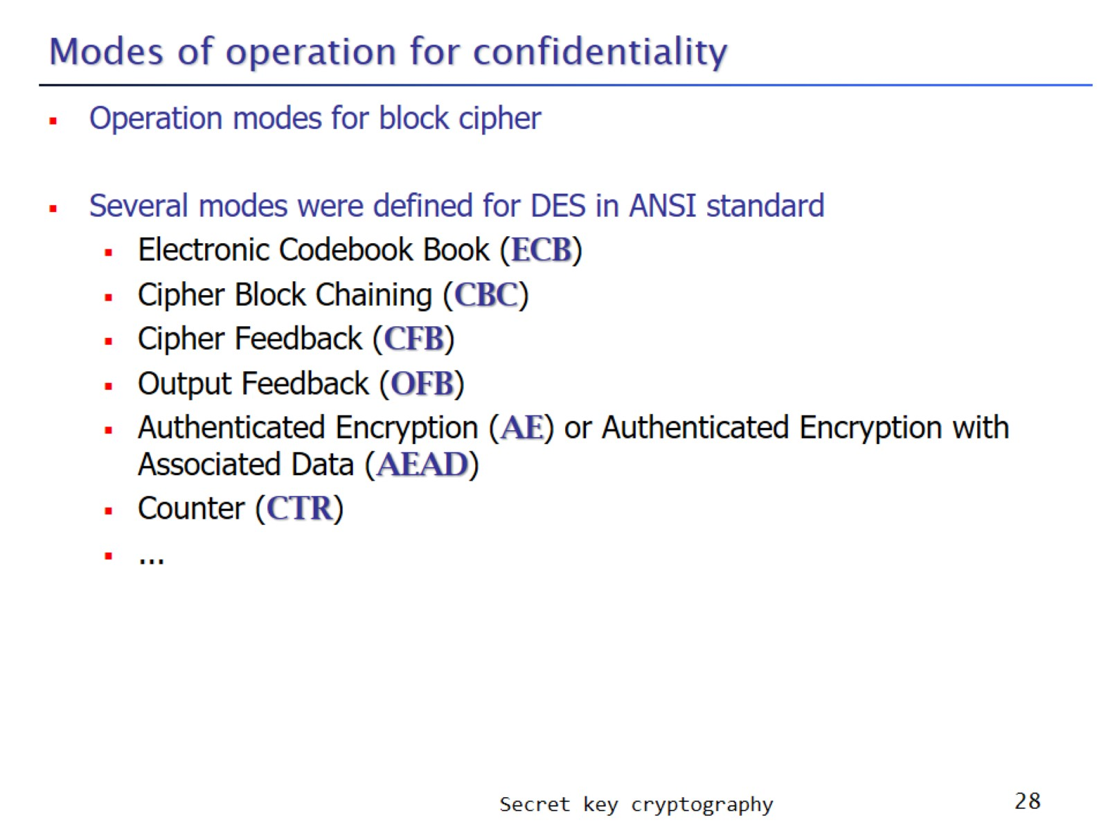
Modes of operation for confidentiality

Slide 29
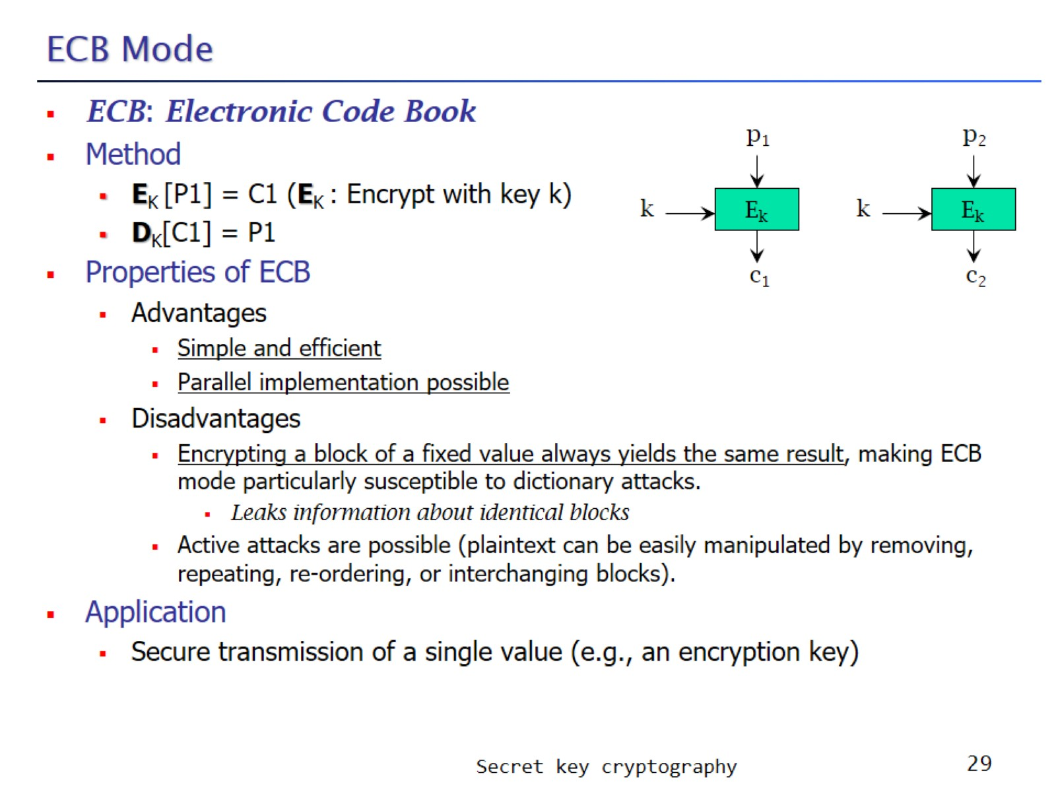
ECB Mode

Slide 30
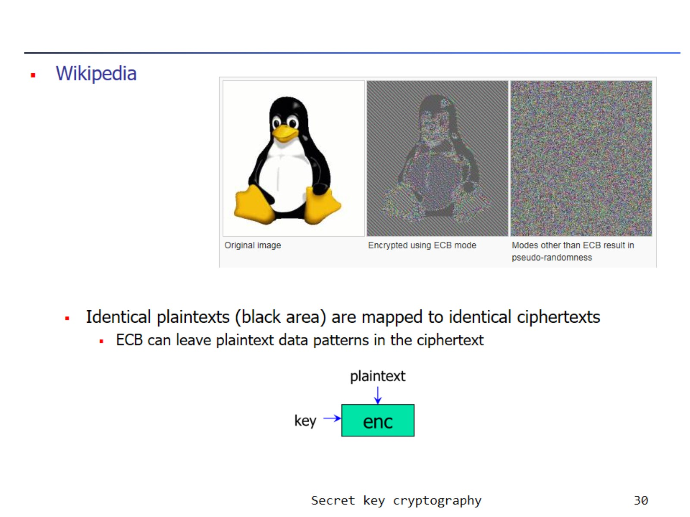

Slide 31
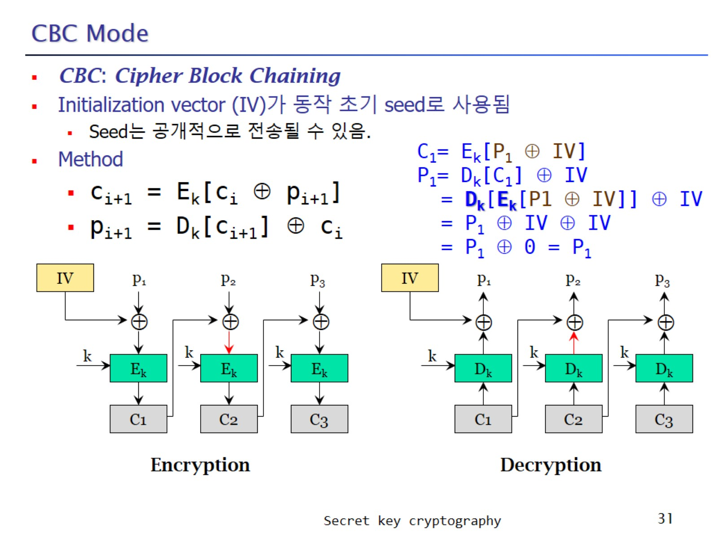
CBC Mode

Slide 32
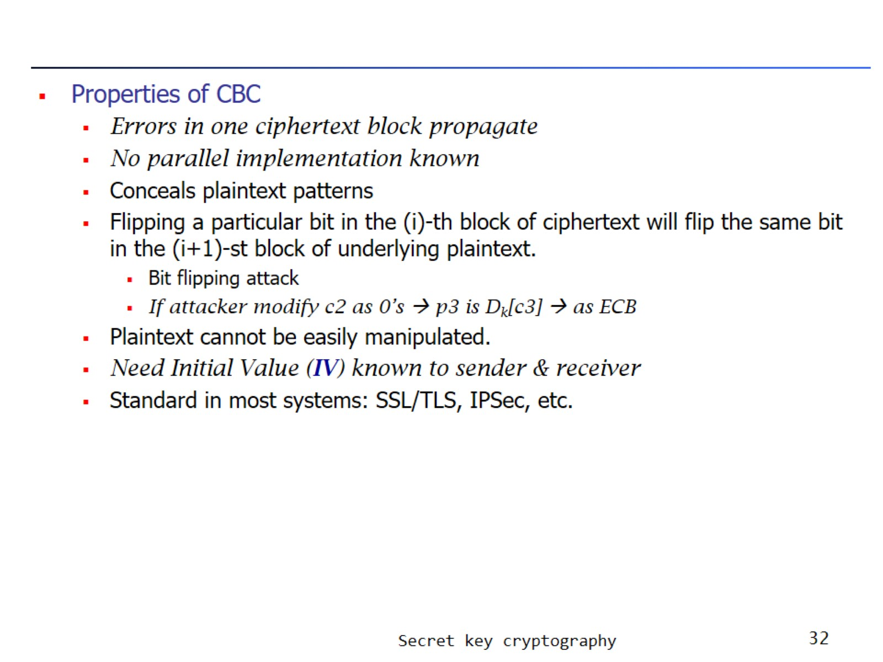

Slide 33
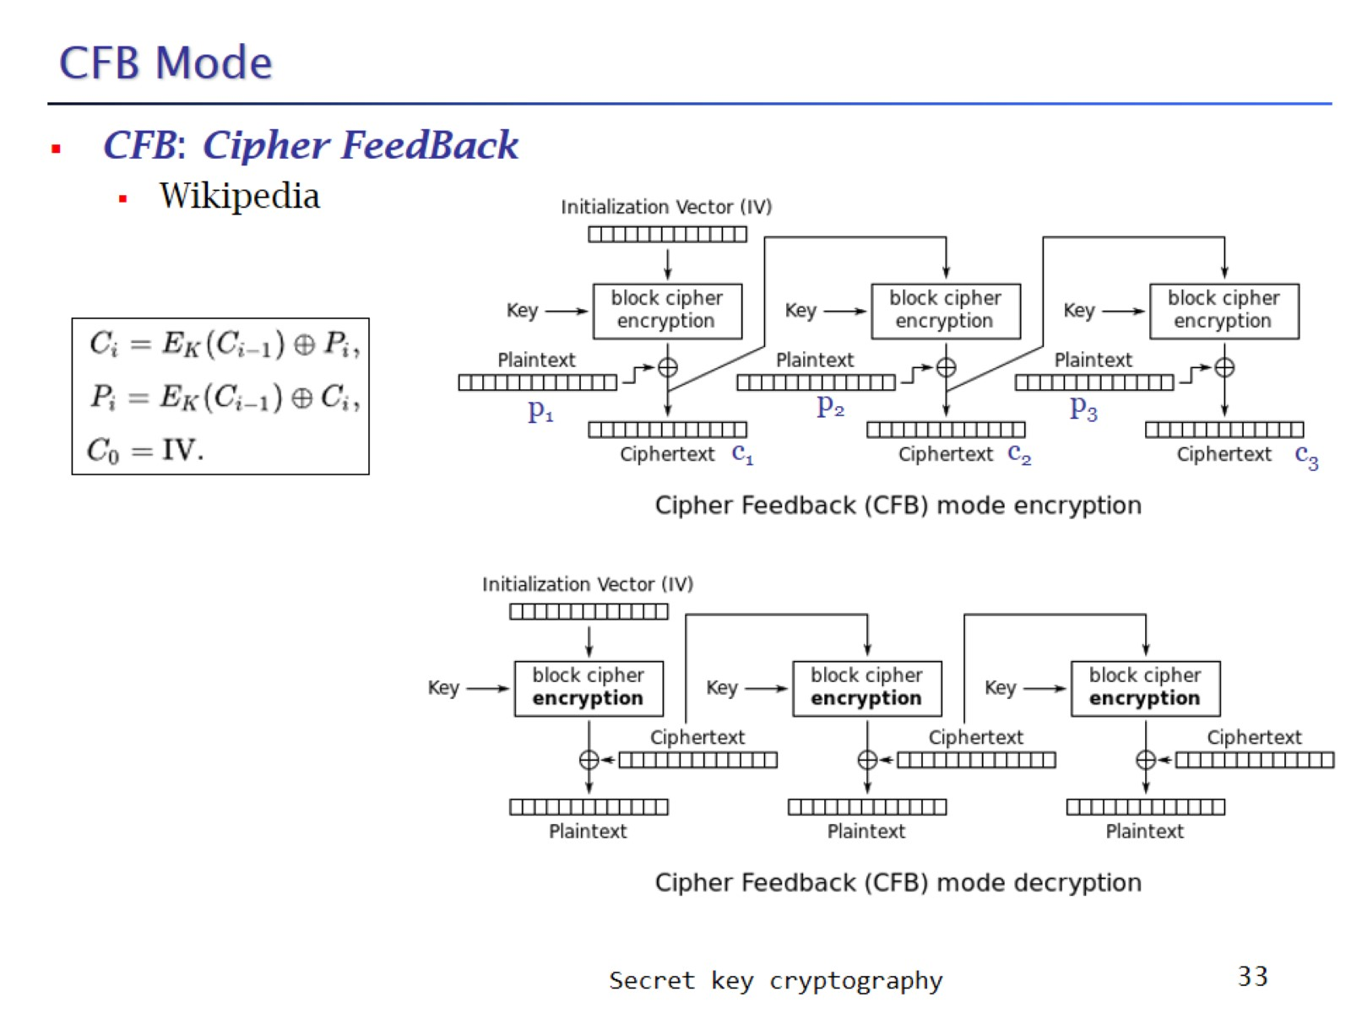
CFB Mode

Slide 34
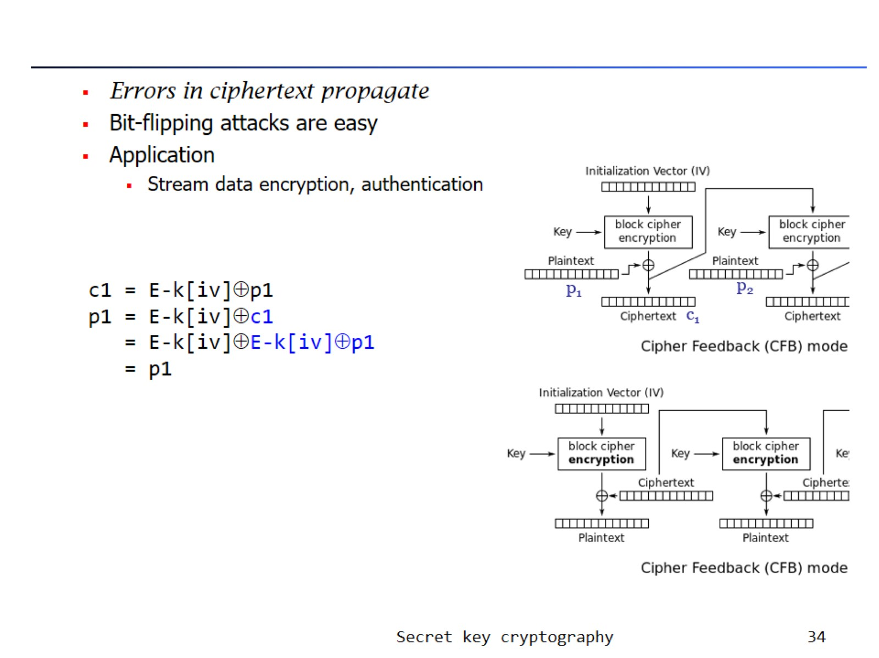

Slide 35
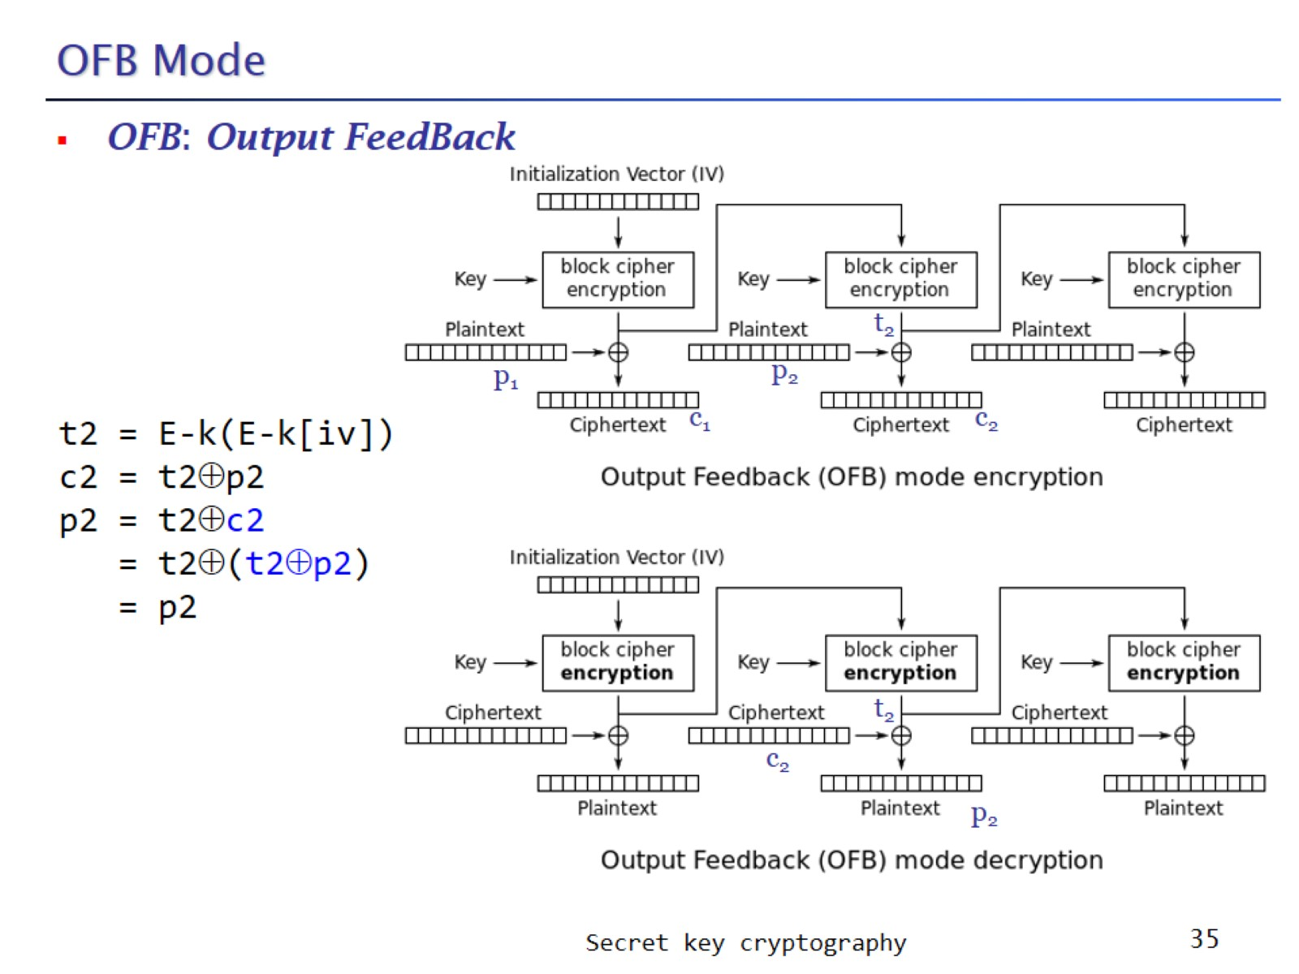
OFB Mode

Slide 36
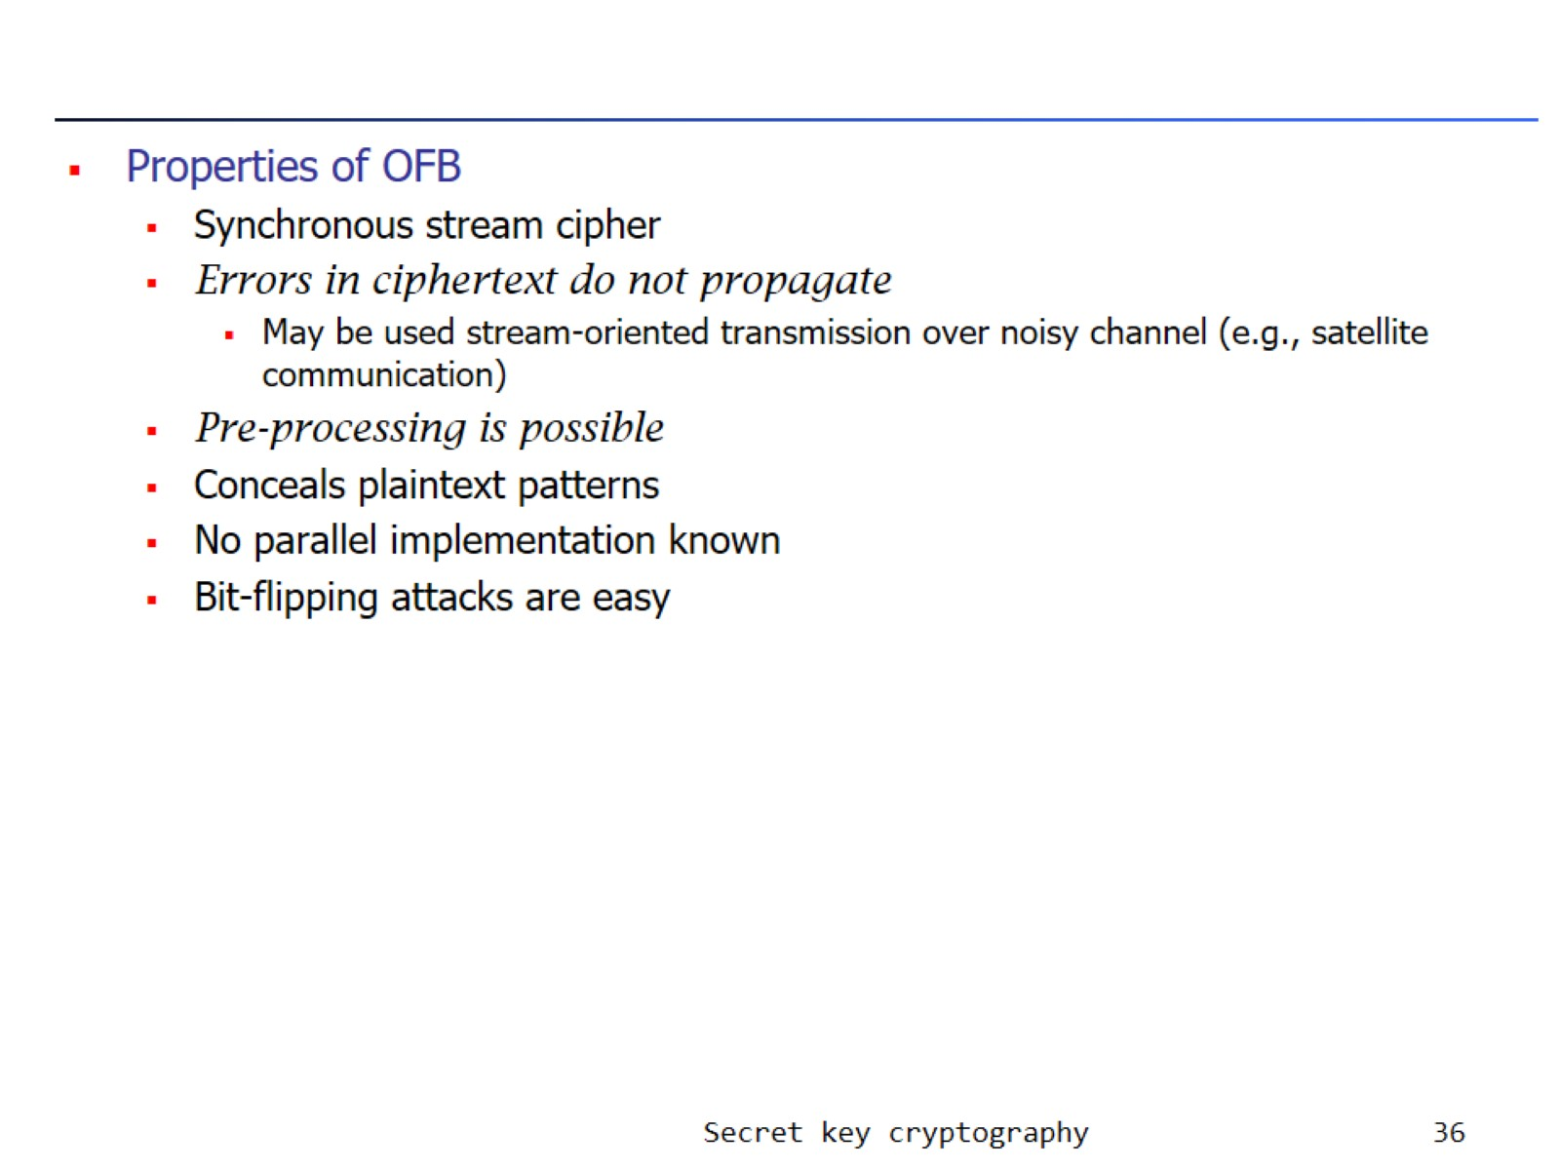

Slide 37
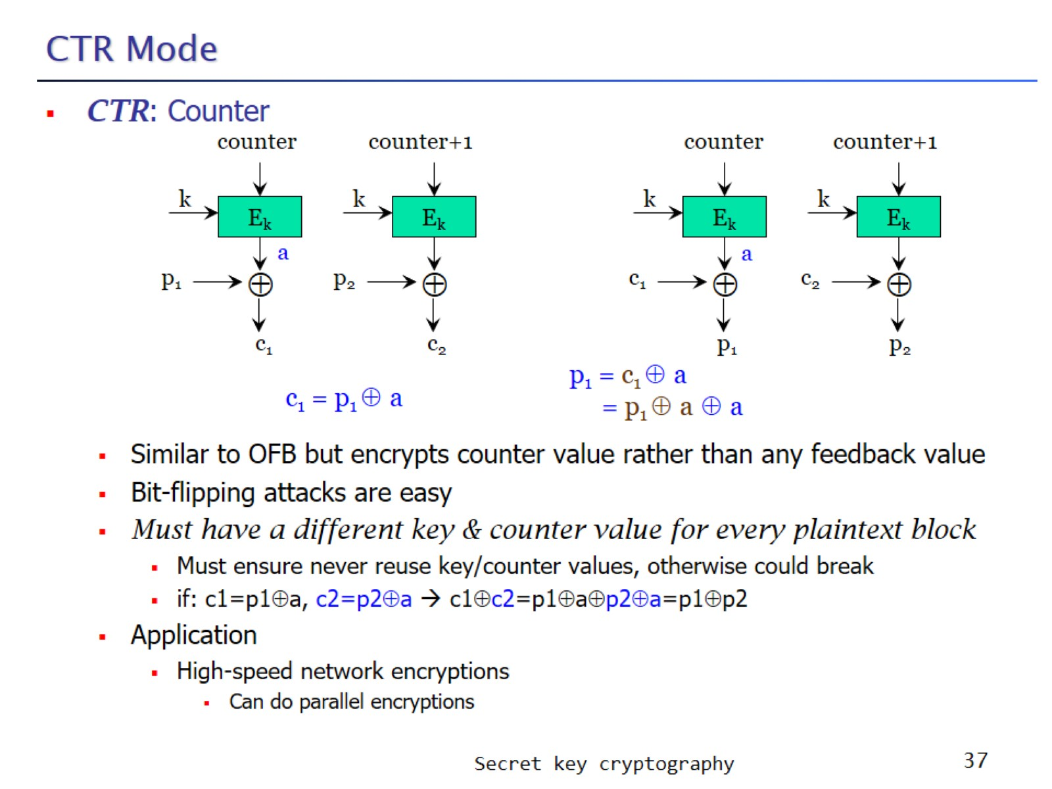
CTR Mode

Slide 38
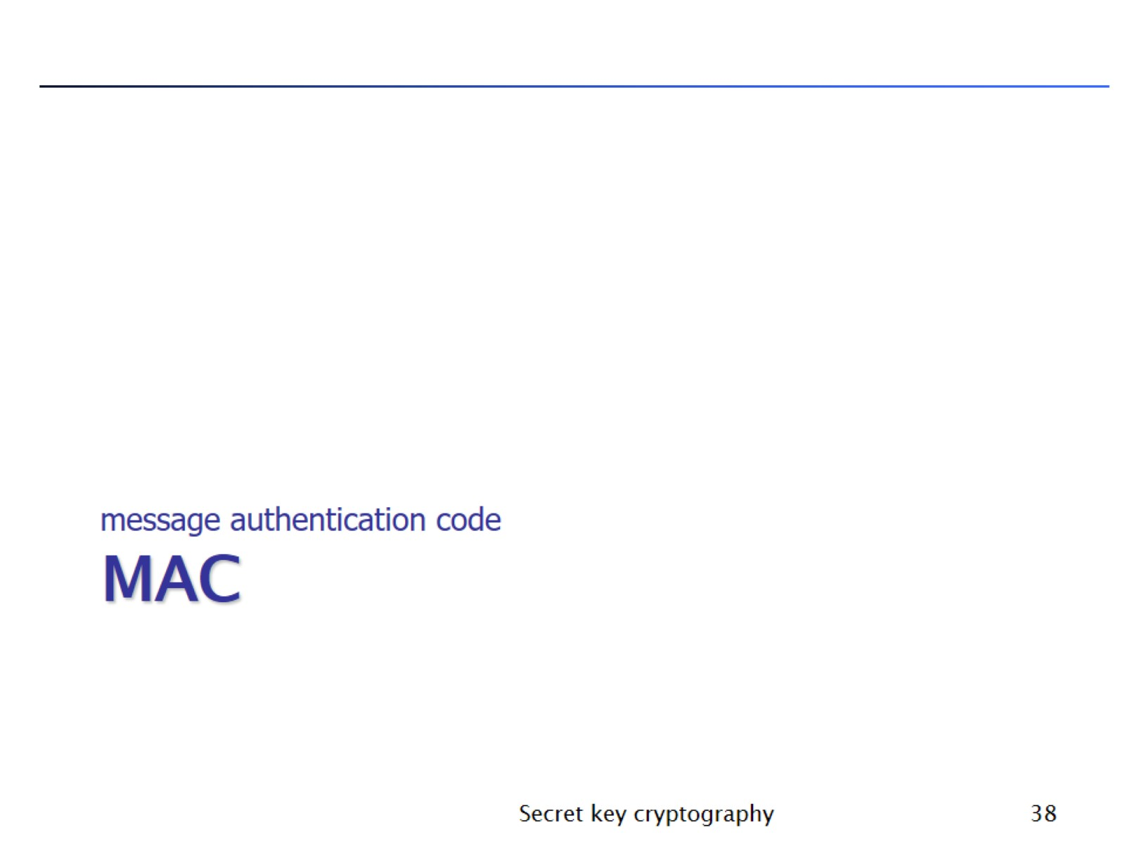
MAC

Slide 39
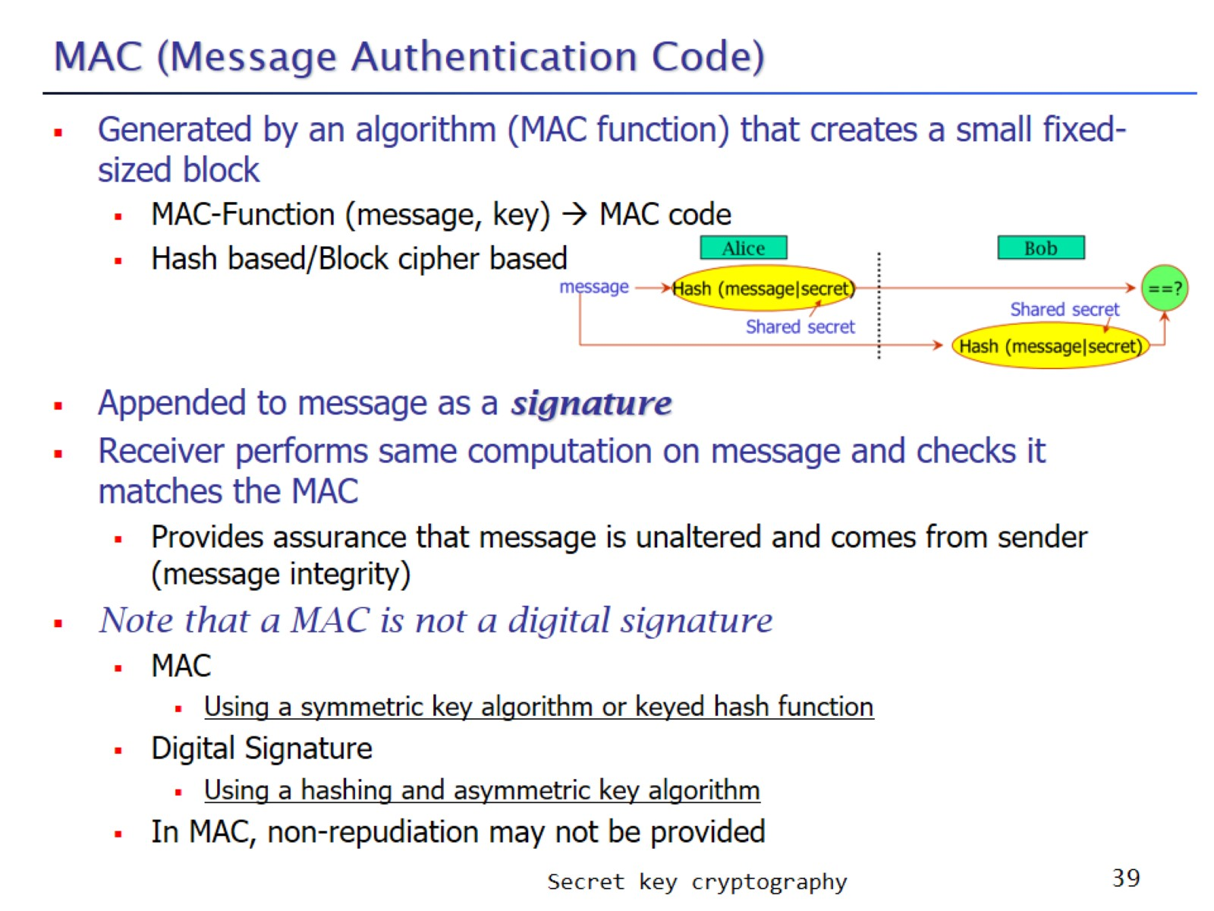
MAC (Message Authentication Code)

Slide 40
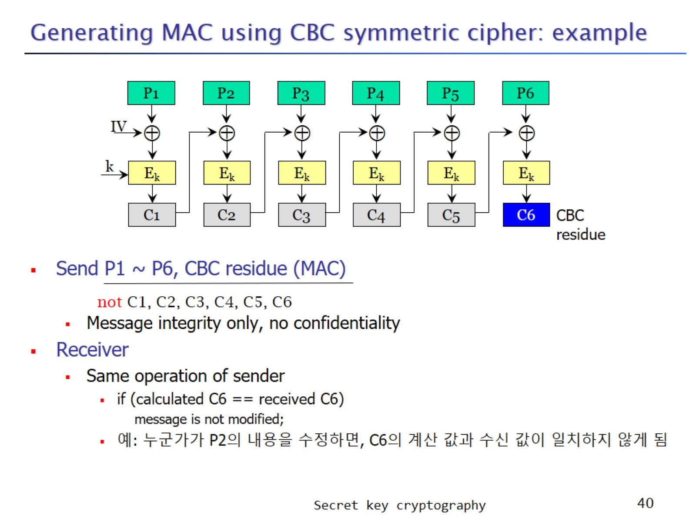
Generating MAC using CBC symmetric cipher: example

Slide 41
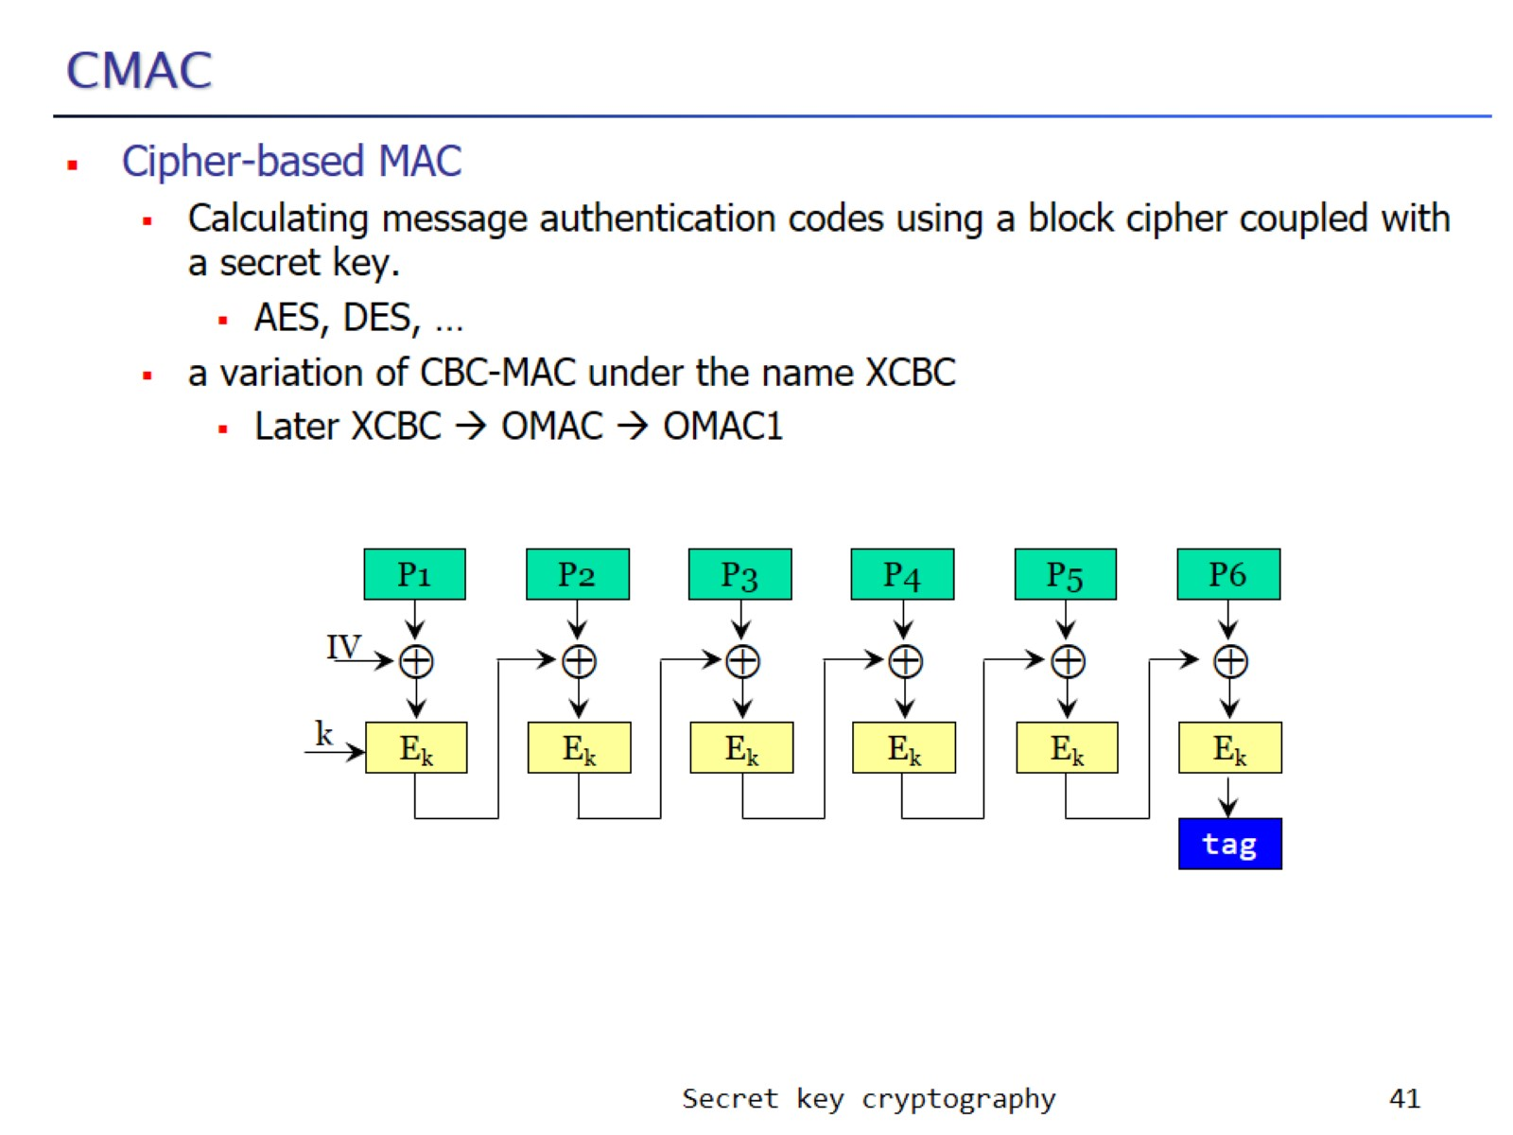
CMAC

Slide 42
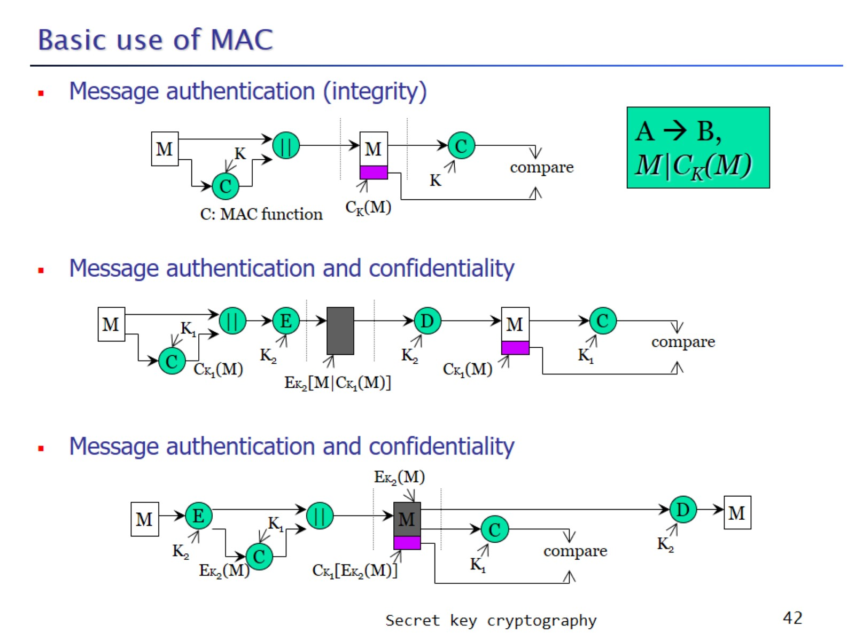
Basic use of MAC

Slide 43
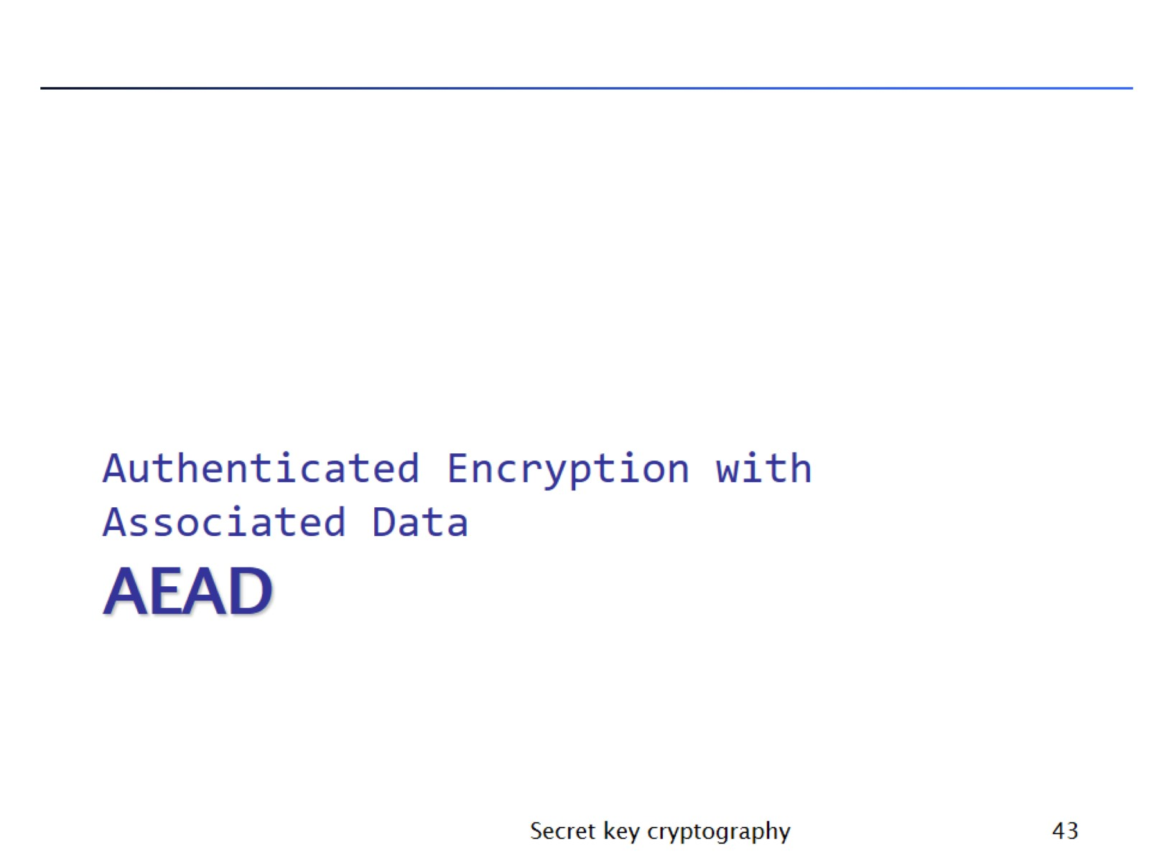
AEAD

Slide 44
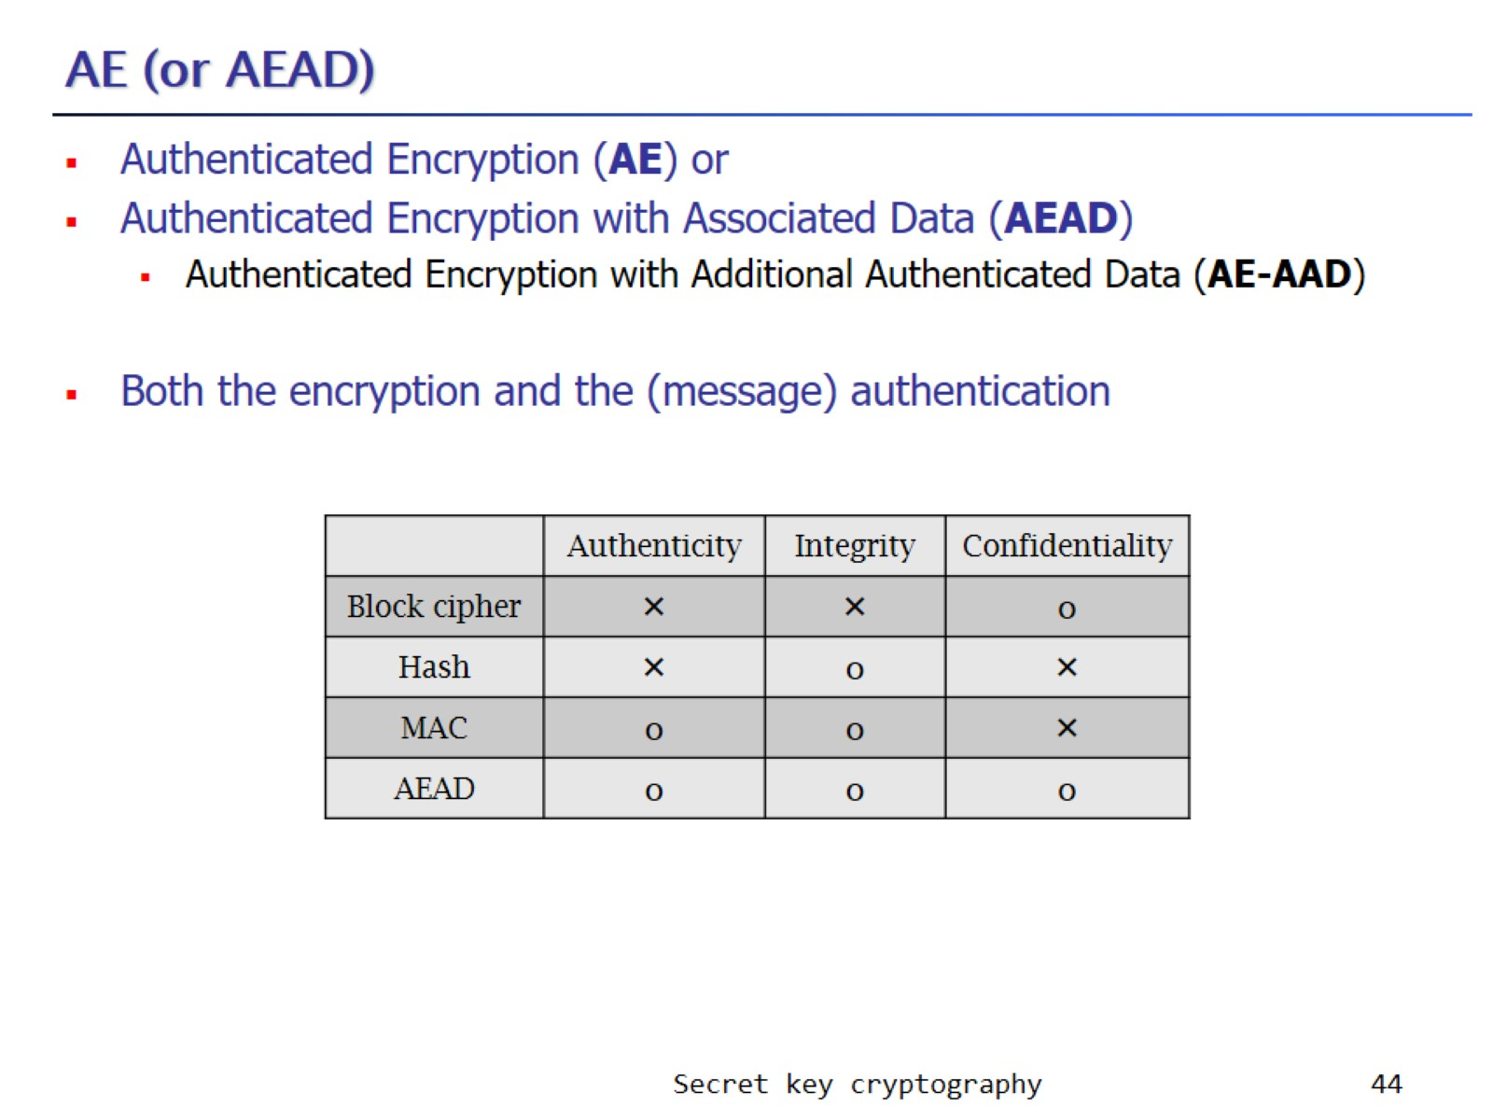
AE (or AEAD)

Slide 45
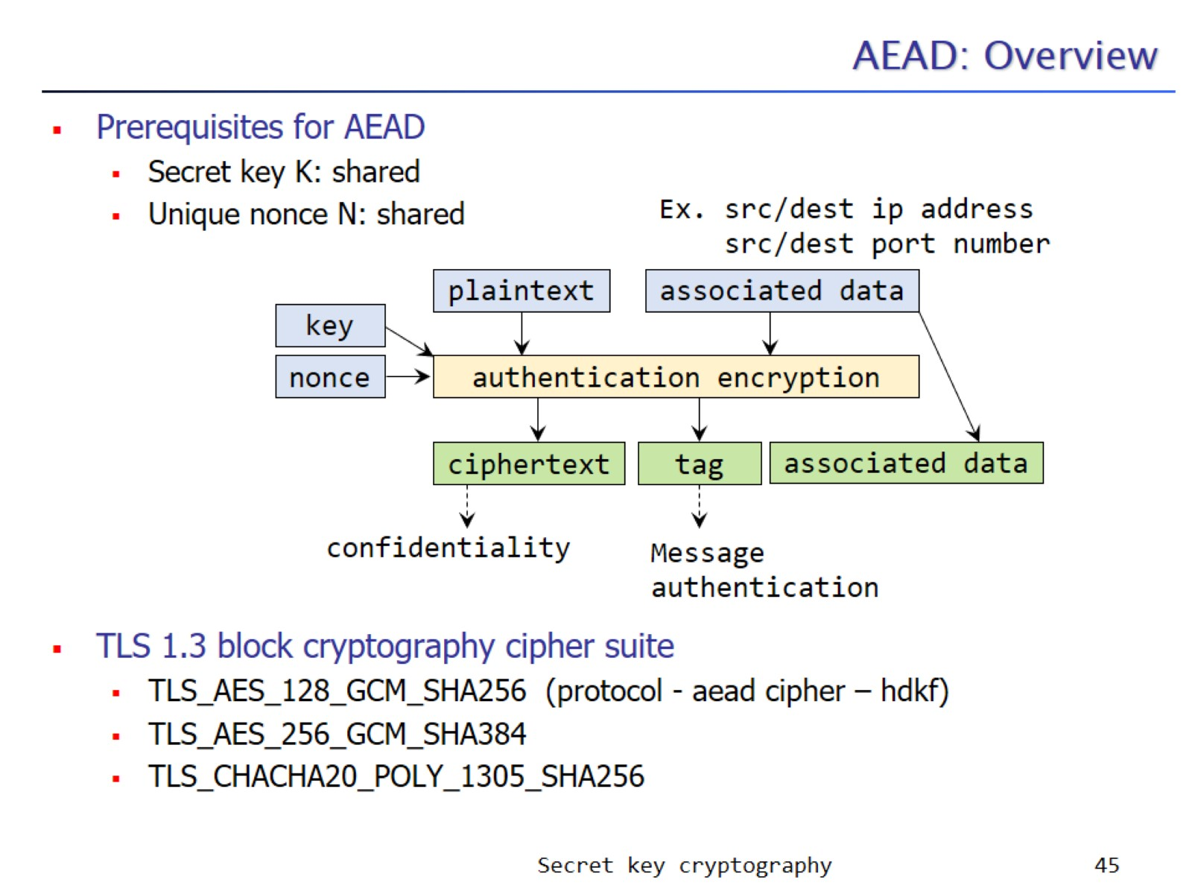
AEAD: Overview

Slide 46
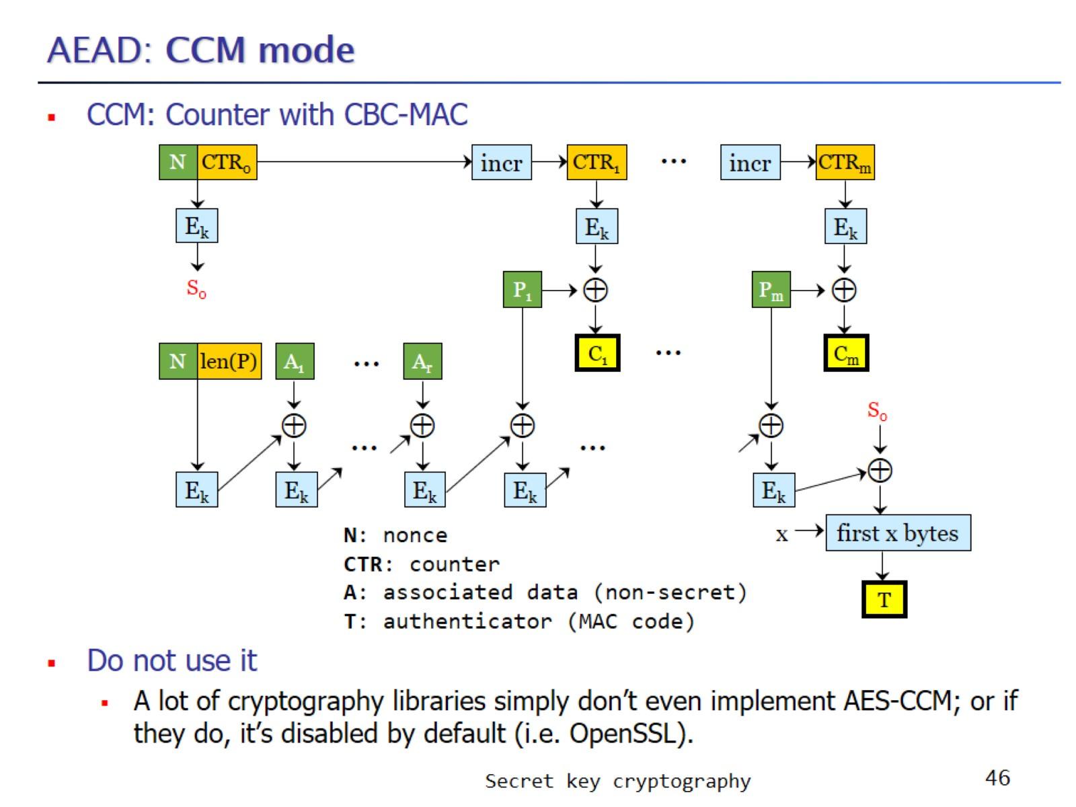
AEAD: CCM mode

Slide 47
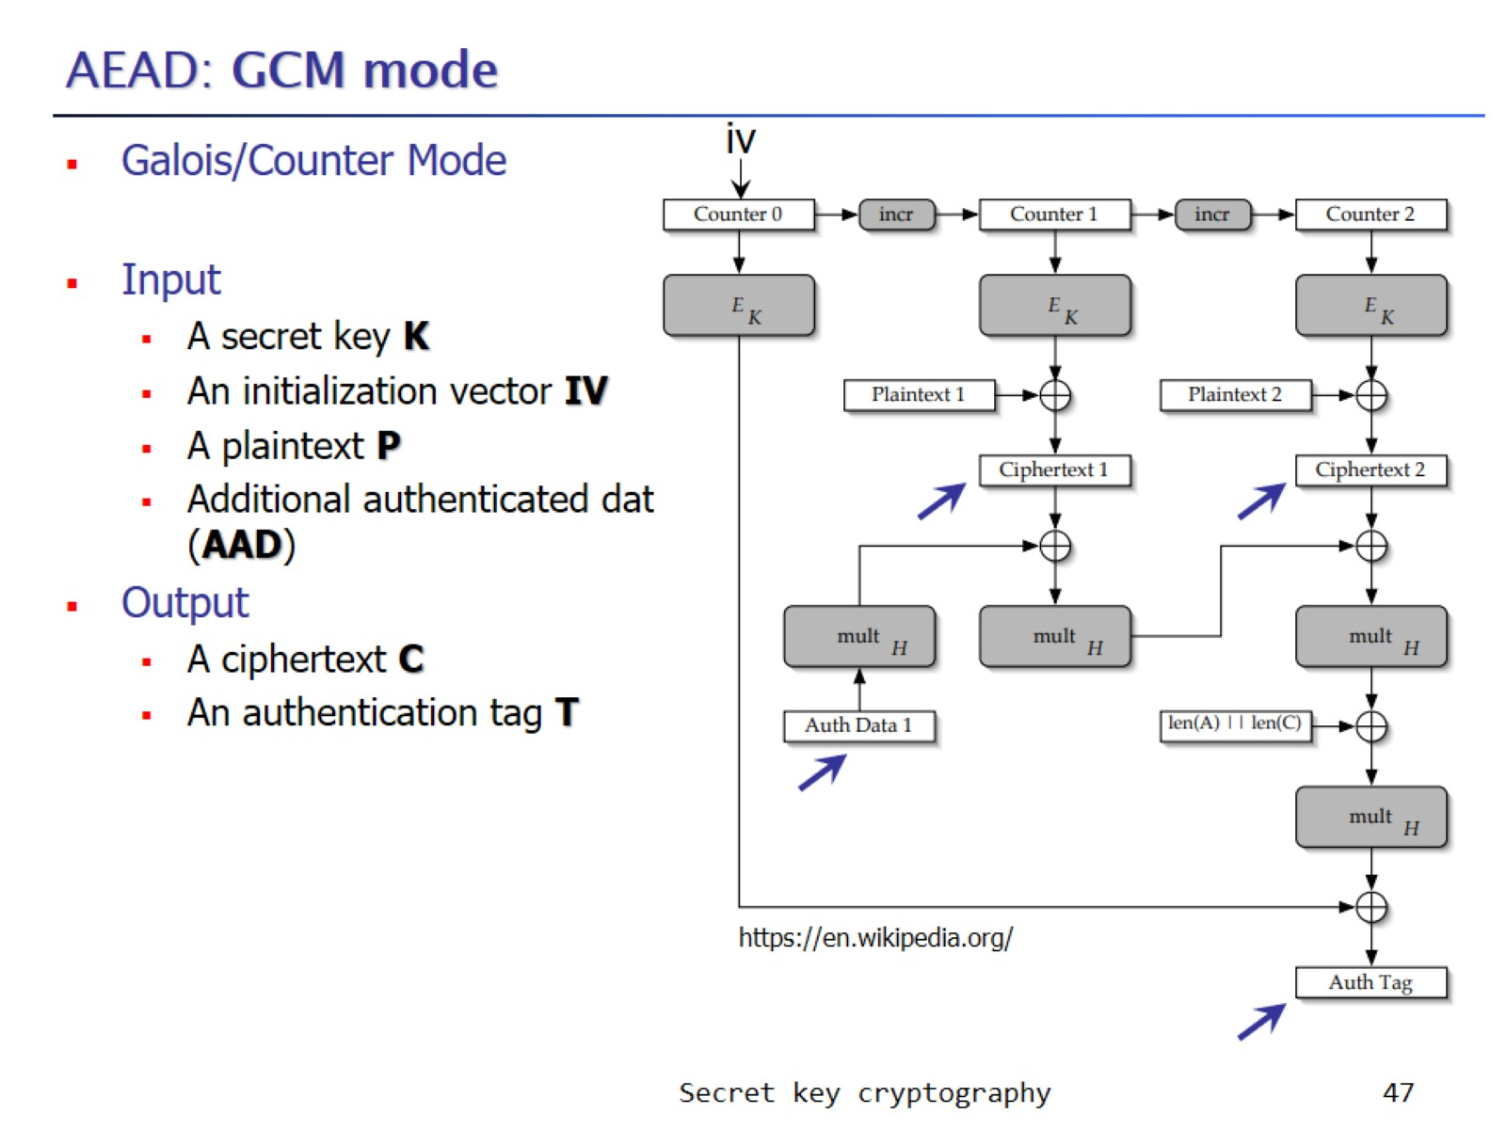
AEAD: GCM mode

Slide 48
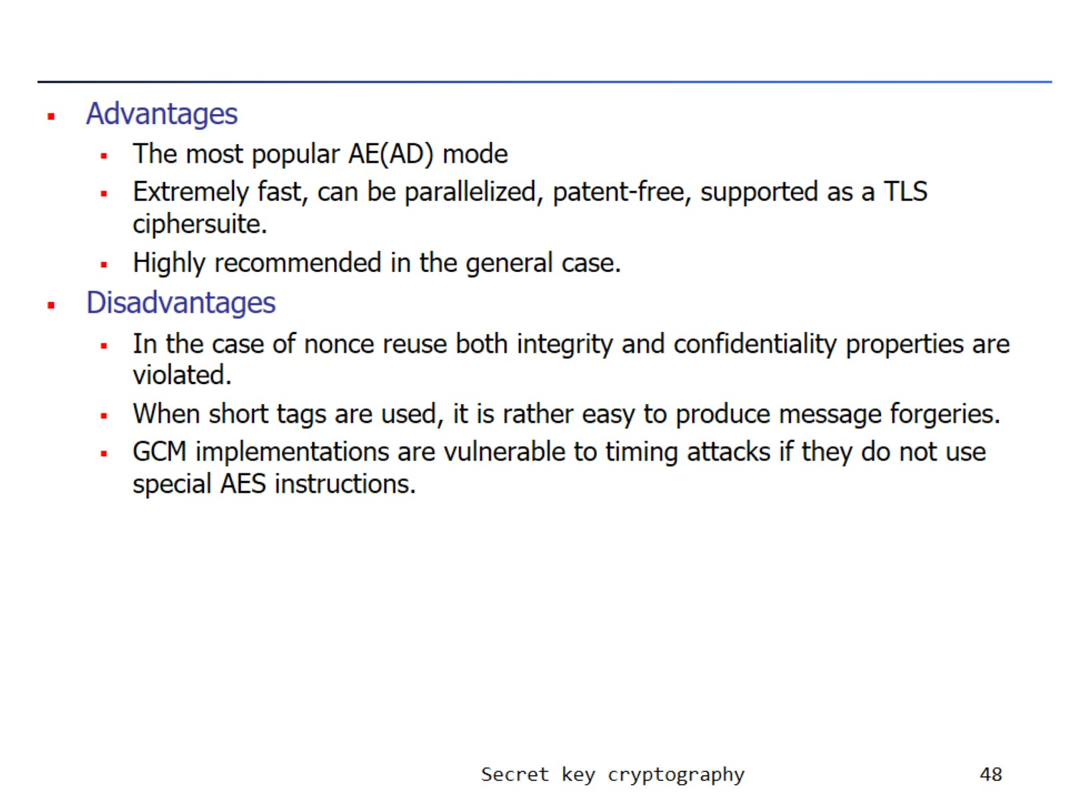

Slide 49
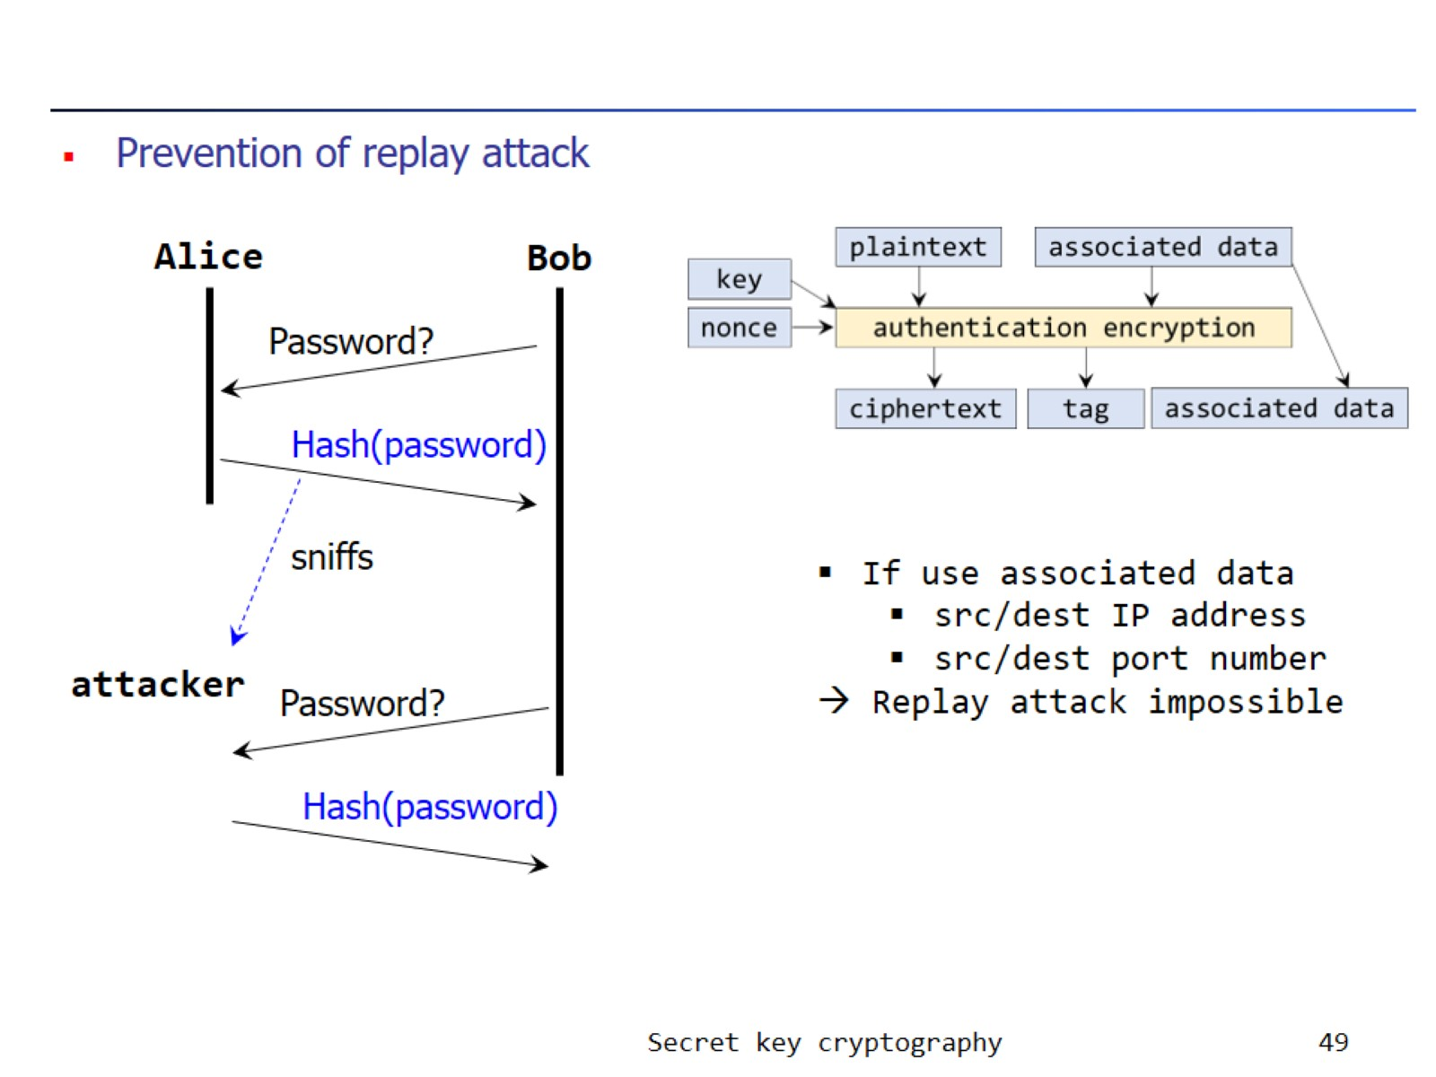

Slide 50
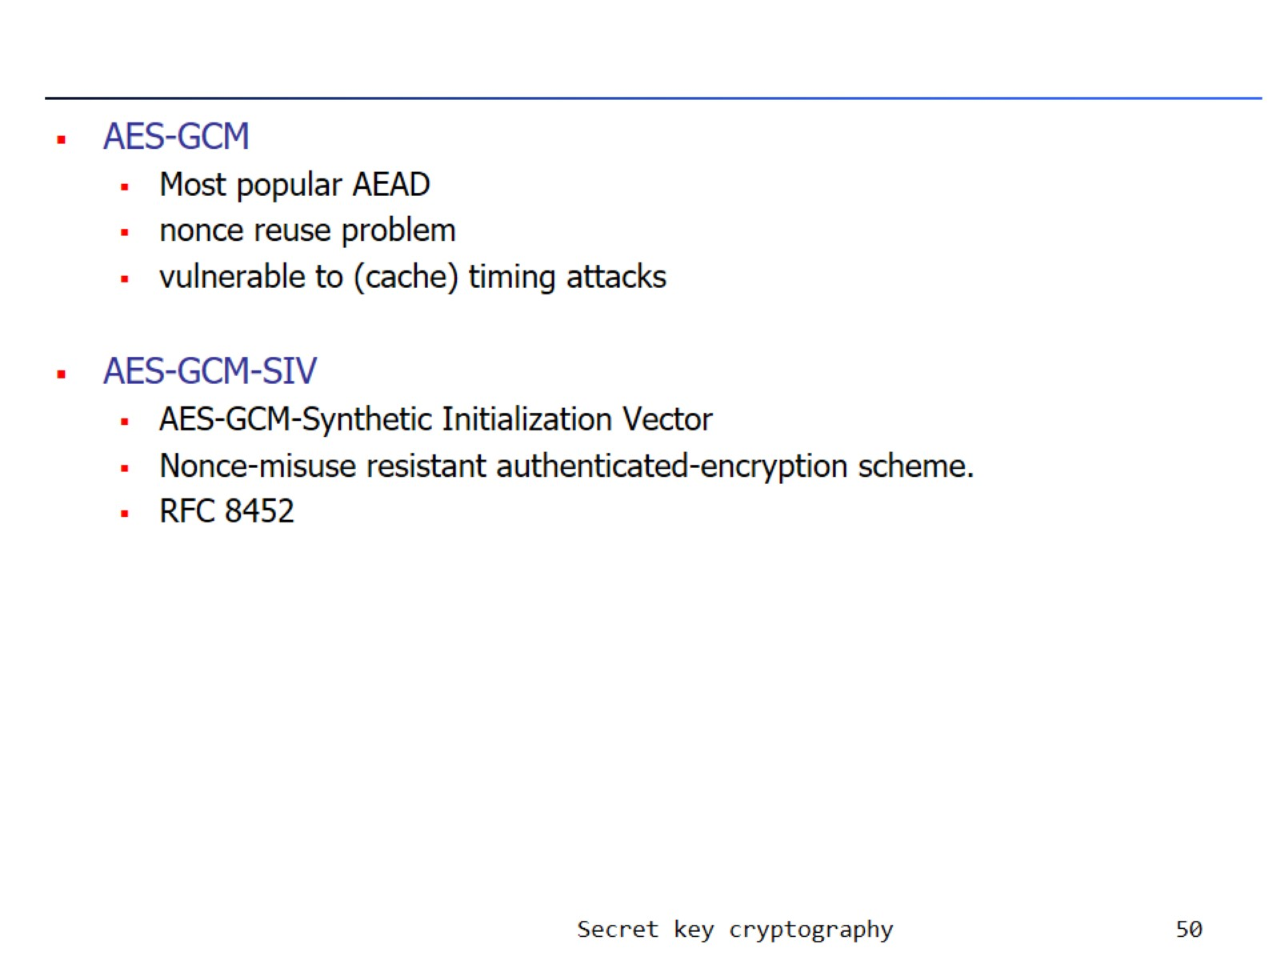

Slide 51

AES-GCM-SIV

Slide 52

AEAD: other modes

Slide 53

3 approaches

Slide 54


Slide 55

Symmetric Encryption Rankings

Slide 56

openssl commands

Slide 57

Let’s play with AES: 실습

Slide 58


Slide 59


Slide 60


Slide 61

Example attack

Slide 62

Length extension attack

Slide 63


Slide 64

Bit/byte flipping attack on CBC

Slide 65

Attack for predictable IV

Slide 66

terminology

Slide 67

Attacks on CBC mode operation (2011, BEAST attack)

Slide 68


Slide 69


Slide 70

Forbidden Attack

Slide 71


